Slide 1


JK Agency Updates
Thursday, March 27th
1PM CST
Zoom Meeting Link
https://zoom.us/j/3738421209

Slide 2







ATTENTION NEW AGENTS
Sell your first application by next Friday, April 4th & receive a Compass shirt* and $100 lead credits!
*May be substituted for a $50 CHC store credit
Email mkrivelow@chcquotes.com to receive
Connect with us!
If you’re not receiving CHC communications (email and texts), please email Mari Krivelow at mkrivelow@chcquotes.com
Follow us!

Slide 3




Do you know someone looking for a new career?
Our next CHC New Agent Training & Development is April 8 & 9th in Tampa. Send your referrals to Liz Wardrop, ewardrop@chcquotes.com, and you could get a $1,000 cash bonus when the new recruit hits their 10th paid application. The new agent must hit the 10th paid application in their first
three months.
*Must have a $25 minimum premium per application
*ACA plans do not qualify

Slide 4

UPCOMING
TRAININGS
Kickstart
Team Dials with Q&A
March 28 - Attitude is Everything
April 1, 15, 29 - Expectations & Action Plans
April 2, 16, 30 - Show Me the Money
April 3, 17 - Handling Objections
April 4, 18 - How to Build Your Business
April 10, 25 - Attitude is Everything
April 11, 28 - Elevator Speech & First 5 Seconds
April 14, 24 - Foundations
April 1, 8, 15, 22, 29
New Agent Training
April 8 & 9: Tampa
April 22 & 23: STL
Dialing for Dollars
Thursday Trainings
April 5 & 19
April 3: Life Insurance
April 10: JK Agency Updates Call
April 17: Under 65 Products
April 24: JK Agency Updates Call
Medicare
Medicare Minute Wednesday Every Wed Morning
NEW! Agent Support Training
Monday Madness
April 7: Dental / Vision Plans
April 14: Foundation Mental Wellness
April 21: FlexBenefits
April 28: AmeriBenefit
Every Tuesday at 9am
NEW! LifeX Webinars
March 31
**MORE INFORMATION ON CHCAGENTS.COM

Slide 5




Affiliate Site NEW UPDATE
Contact mkrivelow@chcquotes.com to get your own webpage!
You can now integrate your website with TopBroker!!!
GET FREE (LIMITED TIME): $40 lead credit until May 5

Slide 6


For more info, please contact Holly Adkison at Hadkison@chcquotes.com or call 636-280-9229

Slide 7



Gigcare
Discussion
Notes:
courtney for major issues in bullet point form - court to speak on during call

Slide 8


AGENT SUPPORT
Please wait a MINIMUM of 24-48 hours before sending the same inquiry to agent support.
Please do NOT to cc: clients on agent support
Customer support email is for Open Enrollment
We’ve added an Agent Support Updates Call every Tuesday morning at 9am CST on a NEW LINK. Please reference chcagents.com. INVITE YOUR DOWNLINES!
If you’re not there by 9:05, you will not be let in to the training. You can find the recordings on chcagents.com in the video library!

Slide 9
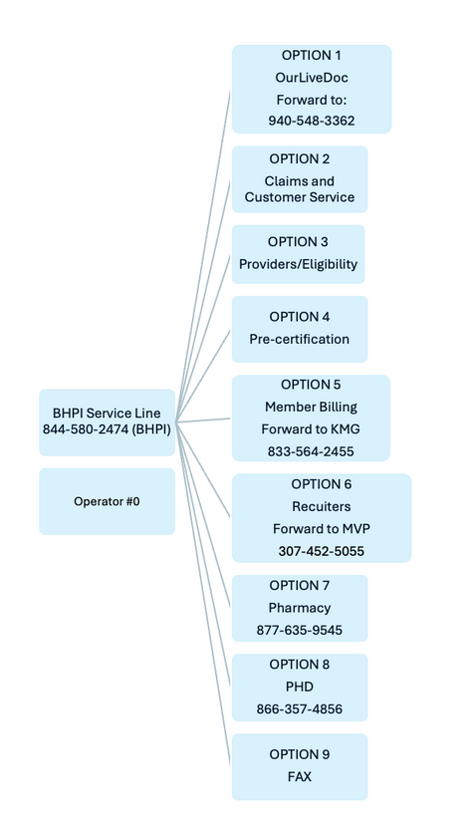

Phone Tree
844-580-2474 (BHPI)

Slide 10



LIFEX WEBINARS WILL BE ON CHCAGENTS.COM CALENDAR
FIND MORE INFORMATION AND ALL PLAN DOCUMENTS ON
LIFEXPLANS.COM
**Sign in and have access to all documents
Notes:
courtney for major issues in bullet point form - court to speak on during call

Slide 11

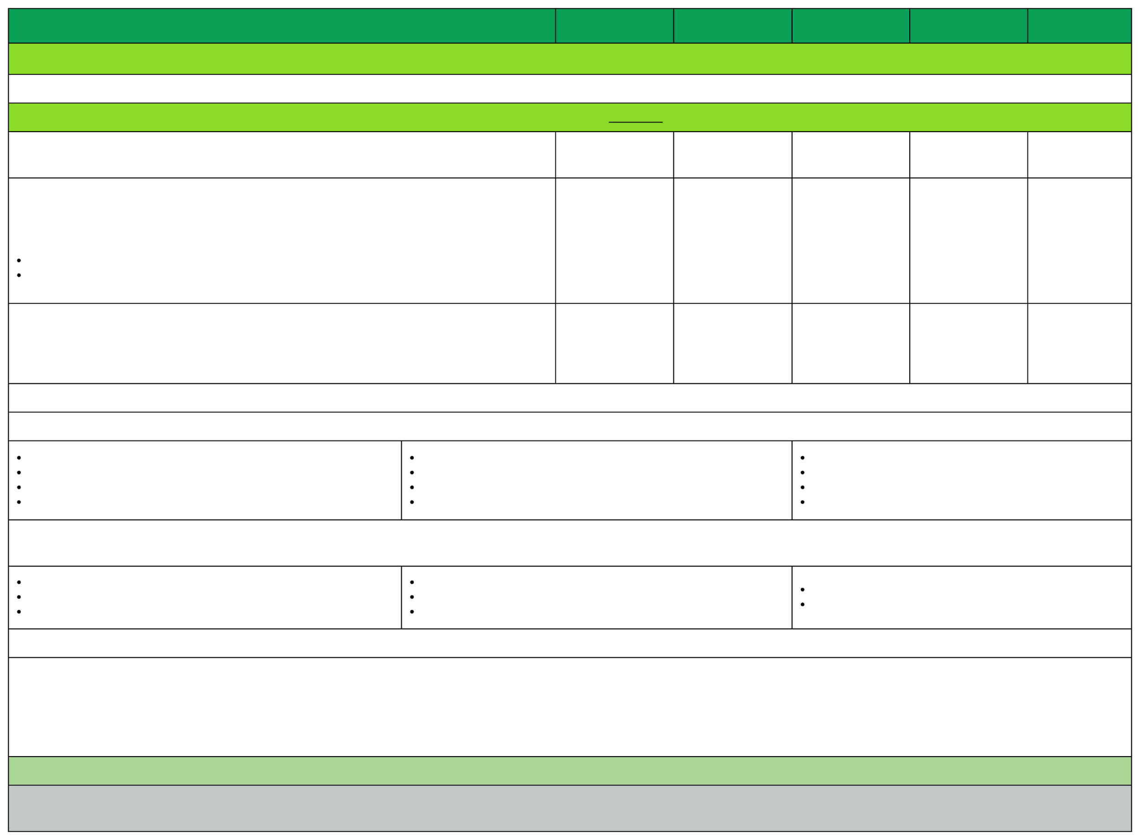
Plan Comparison: Summary of Benefits & Coverage
Rates effective as of January 1, 2025
PLAN
Payment for Services
VL $250
VL $500
VL $750
VL $1,000
VL $1,500
In-network Provider: The provider network is shown on your I.D. card. For help in locating in-network providers, click here.
Maximum Annual Benefit
See Services
Performed
See Services Performed
See Services Performed
See Services Performed
See Services Performed
Deductible (The amount the Covered Person pays each benefit year for Covered Services before the
Coinsurance is payable.)
$250 $500
$500 $1,000
$750 $1,500
$1,000 $2,000
$1,500 $3,000
Individual
Family
Out-of-Pocket Maximun (For member accumulated deductible and copays (Individual/Family) Out of Pocket – Maximum for services beyond the plan visit limits
$9,200 $18,400
Unlimited
$9,200 $18,400
Unlimited
$9,200 $18,400
Unlimited
$9,200 $18,400 Unlimited
$9,200 $18,400
Unlimited
Copays: Please note that after your deductible has been met, you will still be responsible for paying copayments for your medical services. Other Covered Services (Limitations may apply to these services. This isn’t a complete list. Please see your plan document.)
Annual Lab/X-Ray Tests
Annual Pap Smear/Mammogram
Cancer Screenings
Colonoscopies
Diabetic Supply
Immunizations
Other Preventative Screenings
Precision Rx (Prescriptions)
Telemedicine (including Mental Health Services) Urgent Care and Office Visits Well Baby Care Wellness Visits
Services Your Plan Generally Does NOT Cover (Check your policy or plan document for more information and a list of any other excluded services.)
Acupuncture
Children’s Dental Check-Up
Children’s Glasses
Children’s Eye Exam
Dialysis
Biofeedback
Substance Abuse Services
Organ Transplant Services
Services may require preauthorization. Failure to obtain preauthorization will result in denial of benefits. Precertification
Precertification is required for all in-hospital admissions, imaging (CT/PET/MRI/MRA), home health, skilled nursing, hospice, DME (over $500), chemotherapy/radiation, sleep studies, prosthetics/orthotics,
therapies (chiropractic, cardiac, PT/OT/ST), and outpatient surgery. Please refer to the plan document for a complete list of all services that require precertification under your plan. A 50% (up to $2,500)
penalty will apply for not obtaining precertification.
Emergencies are covered but do require authorization/certification within 48 hours. This illustration describes the plan in an easily understood manner and is presented as a matter of general information only.
The contents are not to be accepted or construed as a substitute for the provisions of the plan document or summary plan description, which contains more exact terms and detailed provisions of the plan, and
it is not to be considered a policy of insurance.
Notes:
courtney for major issues in bullet point form - court to speak on during call

Slide 12


CHC Finance Department
PAYCOR
We’ve started using a new software program for our direct deposits. They will come from “HST STL LLC”
Be on the lookout for an email from Paycor to set up your agent facing portal within the next week. This is NOT a replacement of EAgent Center - Paycor gives visibility into deposits, NOT commissions.
Agents and managers may receive automated emails that come from “chccontracting@startworktoday.careers” requesting missing information for onboarding paperwork such as SSN, DOB, Voided Check, or W9. These emails are from Compass, please do NOT mark as spam, and please be sure to take action on the request you receive, to avoid delays in commissions for yourself or one of your downline agents.

Slide 13

CHC Contracting Department
Hiring Managers: https://wkf.ms/4cErFQa Request invitation to contract your recruit with CHC
CHC Contracted Agents: CHC Additional Carrier Requests
Link: https://forms.monday.com/forms/9508297440e8ac95cfedbacaeebe7896?r-use1
CHC Contracting Staff: Tanya Mosley & Mimi Crisostomo
Emails: contracting@chcquotes.com contracting@startworktoday.careers
Notes:
add med mutual winners
take med mutual off they need to other links

Slide 14

CHC Contracting Department
  Request LifeX from the Additional Carrier Link, you will need your upline’s LifeX Agent ID
  Please allow a full 2 business days to recieve your testing certification email from KMG. Please do not submit more than once
  If it has been more than 2 full business days, email CHC contracting at contracting@chcquotes.com
  LifeX Welcome Emails will come from support@kmg-services.com, with a Subject Line: Dedicated Enrollment Platform
Notes:
add med mutual winners
take med mutual off they need to other links

Slide 15



Top 10 Agents March 2025/Submitted
*Only Includes Agency Appointed Carriers
RANK
NAME
# OF APPS
1
2
3
4
5
6
7
8
9
10
Thomas Trifaro
Kavon Stevenson
Jeremy Bright
Jennifer Earp
Rachel Elsberry
Robert Weinstein
Lairah Vancil
Phil Vogt
Vicki Powell
Sue Weick
69
38
34
33
33
32
30
25
23
22
Notes:
double check numbers

Slide 16




SALE!
Notes:
double check w tanya.
65 new people paid this month. math aint mathin

Slide 17


JK Call PPTX will no longer be sent via email. To find the powerpoint slides from JK Calls visit chcagents.com video library and click the JK Agency Call Slides Menu Button

Slide 18





Questions? Comments?
Next JK Update: Thursday April 10
Follow us on social media!

