Slide 1




Agency
Updates
Thursday, March 12, 2026

Slide 2

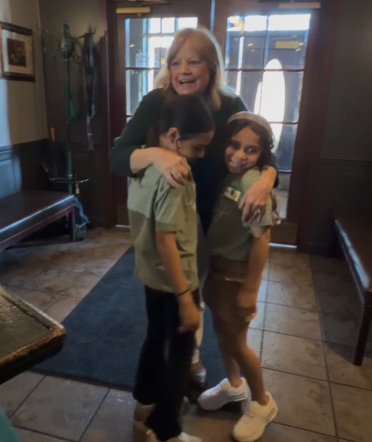
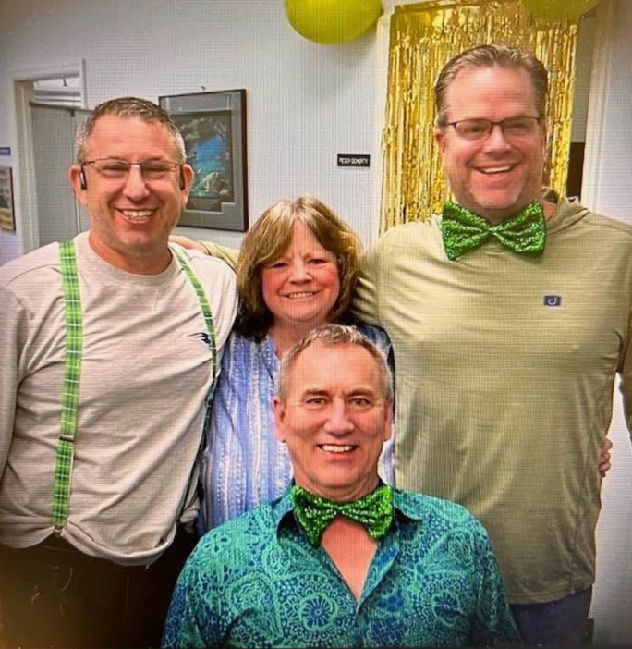
Join us in wishing Peggy the most amazing and LUCKY 70th birthday!!!
We wouldn’t be here if it wasn’t for YOU!
WE LOVE YOU!

Slide 3


attention
new
agents
Sell your FIRST application by next Friday, March 20th & receive a CHC shirt** and $100 lead credits!
**MAY BE SUBSTITUTED FOR A $50 CHC STORE CREDIT

Slide 4







Connect
WITH CHC
If you’re not receiving CHC emails, please email marketing@chcquotes.com.
Text “START” to (314) 742-7842 to receive text messages!
Follow us!

Slide 5

Upcoming
Trainings
Kickstart
Dialing for Dollars
FIRST WEEK OF THE MONTH
March 14 10am CST
Medicare
Thursday Trainings
Medicare Minute Wednesday Every Wed Morning 7:30am CST
March 26: Under 65 Training
Agent Support Training
Every Tuesday at 9am CST
Team Dials with Q&A
Life Insurance Training
March 31 at 5pm CST
Every Thursday at 5pm CST
New Agent Training
LifeX & XGB Group Webinars
March 31 & April 1: STL
LifeX: Wed / Fri at 11am CST **Friday’s will be Q&A
XGB: Wed 4pm CST
**Full information on chcagents.com

Slide 6

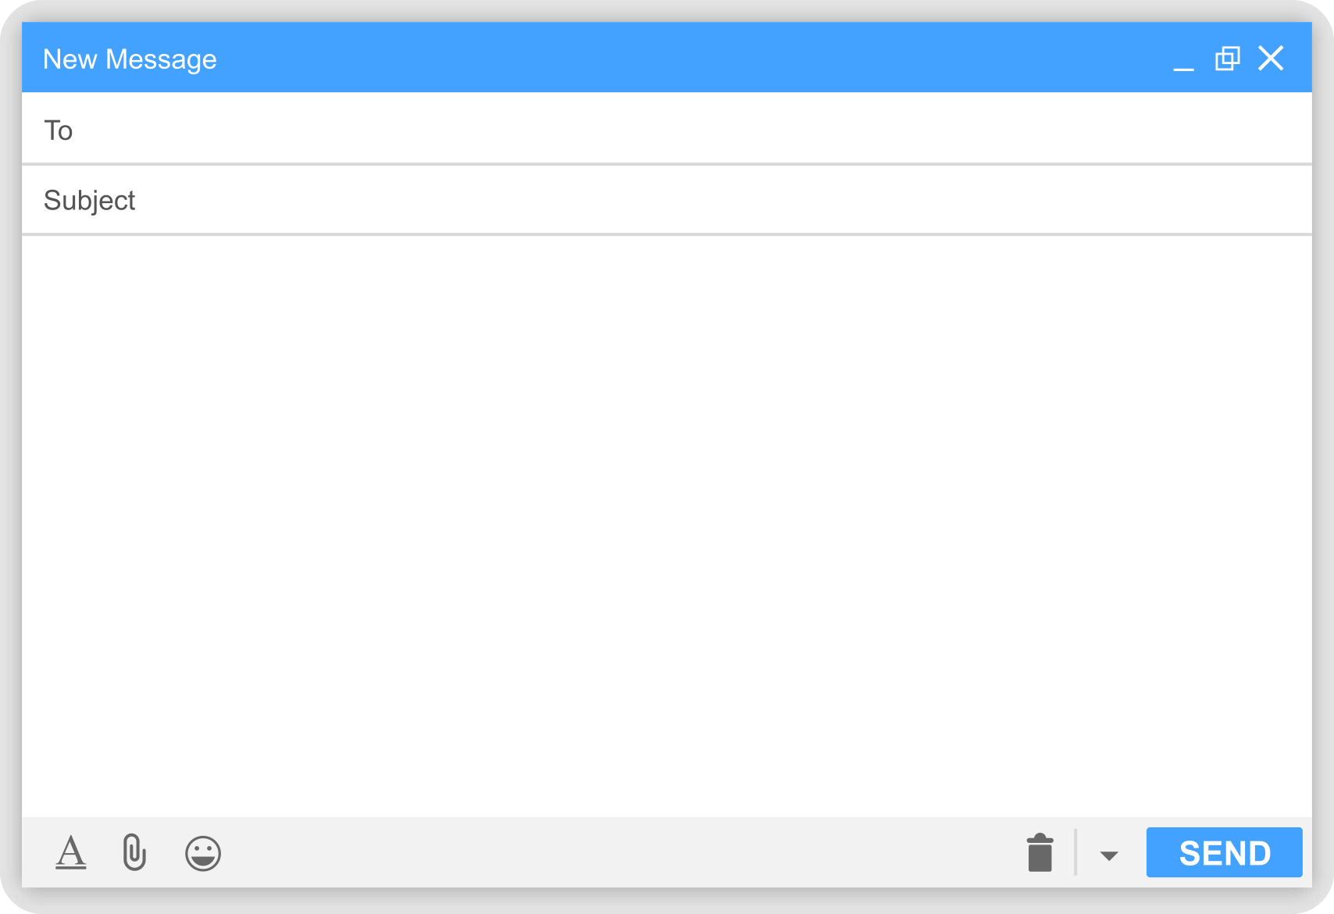
EMAIL ETIQUETTE
Example
Subject Section: All the most specific details of the email
-Who is it for? (Primary Name + Member ID)
-What is it for? (Precert, Claim, ID Card, etc)
Example: Susan Smith - ### - ID Card
Body: Let's get straight to the point, in the best way possible to cut back on any unneeded back and forth.
Susan Smith - ### - ID Card
Afternoon,
Susan Smith ### is needing a physical copy of her (insert product) ID card resent. The coverage includes her spouse William, so he will also be needing a copy.
Sincerely,
Your Fav Agent/Broker/Recruiter
**UTILIZE FOR ALL EMAIL INQUIRIES!

Slide 7




ADVANCED AGENT TRAINING
ELEV8 SUMMIT
St. Louis, MO
Friday April 24th - Saturday April 25th
ELIGIBILITY REQUIREMENTS:
-Must have been an agent with CHC 18 months or less
-Must have written/completed at least two sales applications
REQUEST AN EVITE INVITATION:
By sending your name, cell, and email address to events@chcquotes.com
**IN PERSON TRAINING ONLY

Slide 8

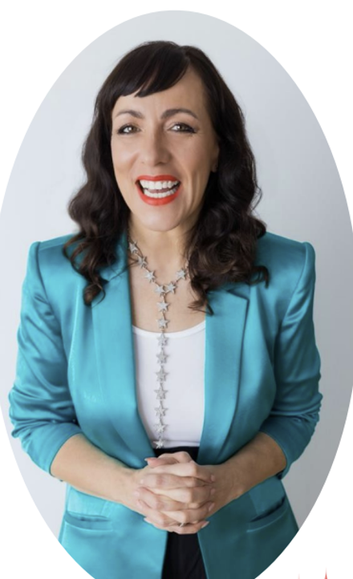
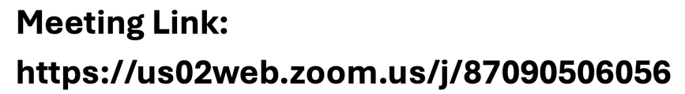
Invites going out soon! Please register by emailing your interest to Amy at events@chcquotes.com
Join us for an interactive, team building workshop!

Slide 9



CHC WOMENS COUNCIL
LET’S MEET UP!
Are you attending the annual award trip in March? We’d LOVE to see you!
Friday, March 20th at 8:30am at the Buffet!
Email marketing@chcquotes.com your phone number if you’re interested in attending!
**If you aren’t going on the trip - don’t worry! Our March Women’s Council is the 24th at 3pm!
**If you’re getting notifications and wish to be, send an email to marketing@chcquotes.com!

Slide 10



CHC BRAND KIT
  Download Logo
  Download Caleb
  CHC Colors, Fonts, Tone
  CHC trademark
Find on chcagents.com ⟶ Resources ⟶ Marketing or https://acrobat.adobe.com/id/urn:aaid:sc:US:5734be74-f316-4181-ae5a-d445340e81ef

Slide 11
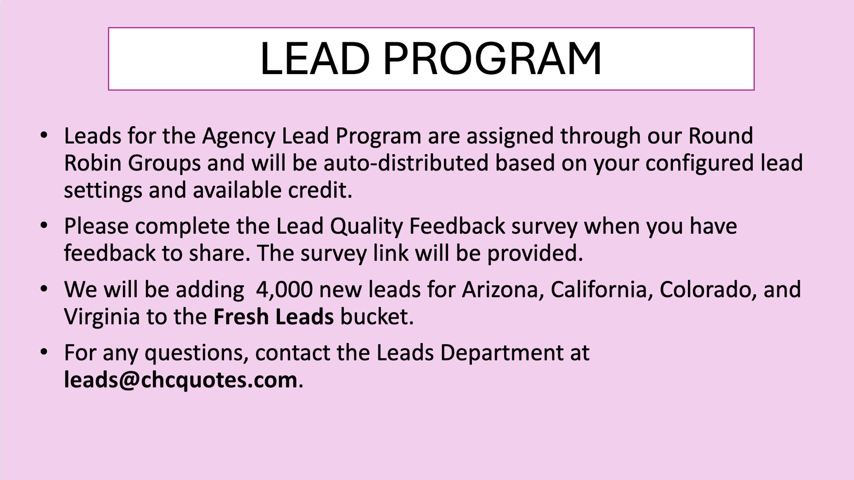

Slide 12
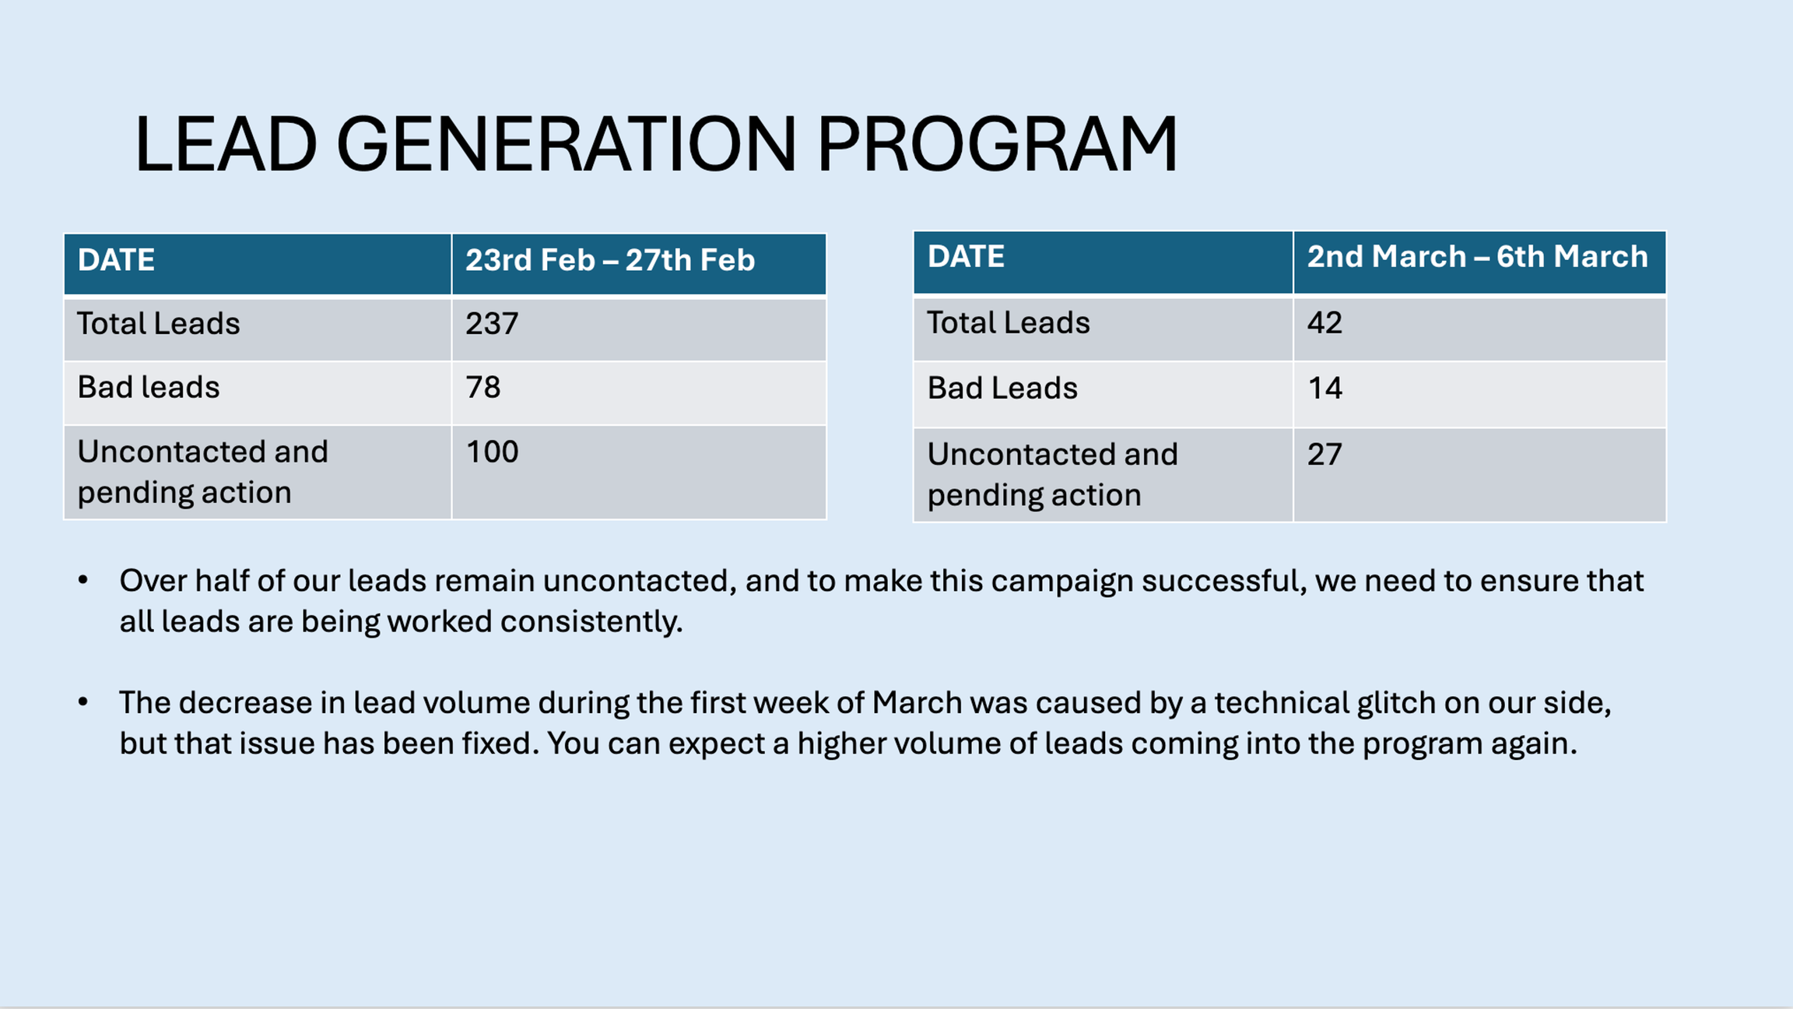

Slide 13

Finance Related Requests
Please remember to submit a pay or hierarchy level change you MUST utilize the Monday.com form found on the chcagents.com site or below: https://forms.monday.com/forms/42c925f26891323fd9906379aa6870ce?r=use1
*You’ll receive a completion notice from the email “Contracting@startworktoday.careers” once the change has been made
**Hierarchy and Pay Level Updates cannot be completed during active processing of carrier statements in our software, due to this restriction, please allow a full pay cycle to pass before requesting an update on the status of your submission

Slide 14
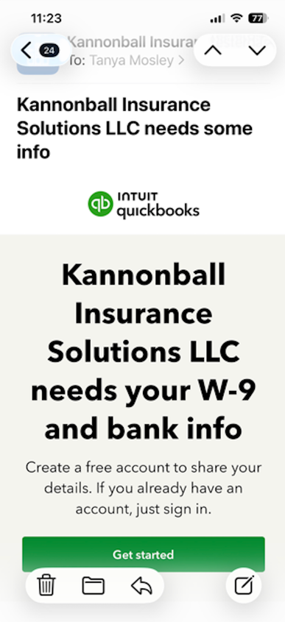
Contracting
KANNONBALL COMMISSIONS: Appearance of commissions link for Kannonball
  Currently have 70 agents who have yet to complete their links
MEDMUTUAL: Ending contracts for agents who have not made a sale within a 12-month period.

Slide 15


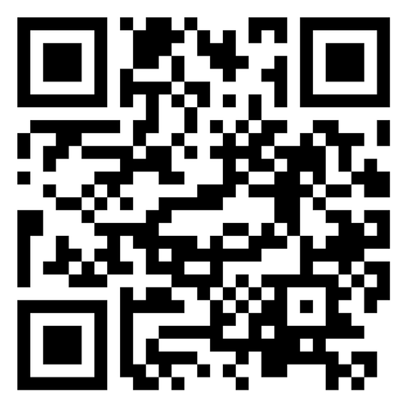

CHC LIFE INSURANCE
Equita: We have a wide variety of carrier and product availability through our IMO partner Equita, if you are looking to add life insurance to your contracts reach out to lifequotes@chcquotes.com or Will Hanks at whanks@chcagents.com. You can also visit the Life Page of chcagents.com for more information. Or scan the following QR code to go to the Equita Appointment Request Form.
Navigator: The Navigator Platform is up and running for those of you with Equita contracts. It's an excellent tool that makes quoting and comparing Final Expense and Term products, with more to be added in the near future!
Notes:
highlighting the Boot Camp, Equita contracting, the Navigator platform, and pointing out the questionnaire, as well as mentioning the next Boot Camp on May 15th, and 16th in Tampa.

Slide 16


CHC LIFE INSURANCE
  The first Life Insurance Boot Camp was a great success, thank you to everyone who took time out of their busy schedules to join us to about the benefits of adding Life Insurance to your portfolios!
  For those of you who attended the first Life Boot Camp, we have sent out a questionnaire! We'd really appreciate your honest feedback so we can know what we are doing right and what we need to work on for the future! As well as what you would like to see from the life department going forward!
  We are holding another Life Insurance Boot Camp! This time it take place in Tampa, May 15th and May 16th, we have increased the number of days as well as the number of possible attendees, so if you missed the last one you can look forward to this one. More information on this event will be available in the coming weeks!
Notes:
highlighting the Boot Camp, Equita contracting, the Navigator platform, and pointing out the questionnaire, as well as mentioning the next Boot Camp on May 15th, and 16th in Tampa.

Slide 17


Slide 18
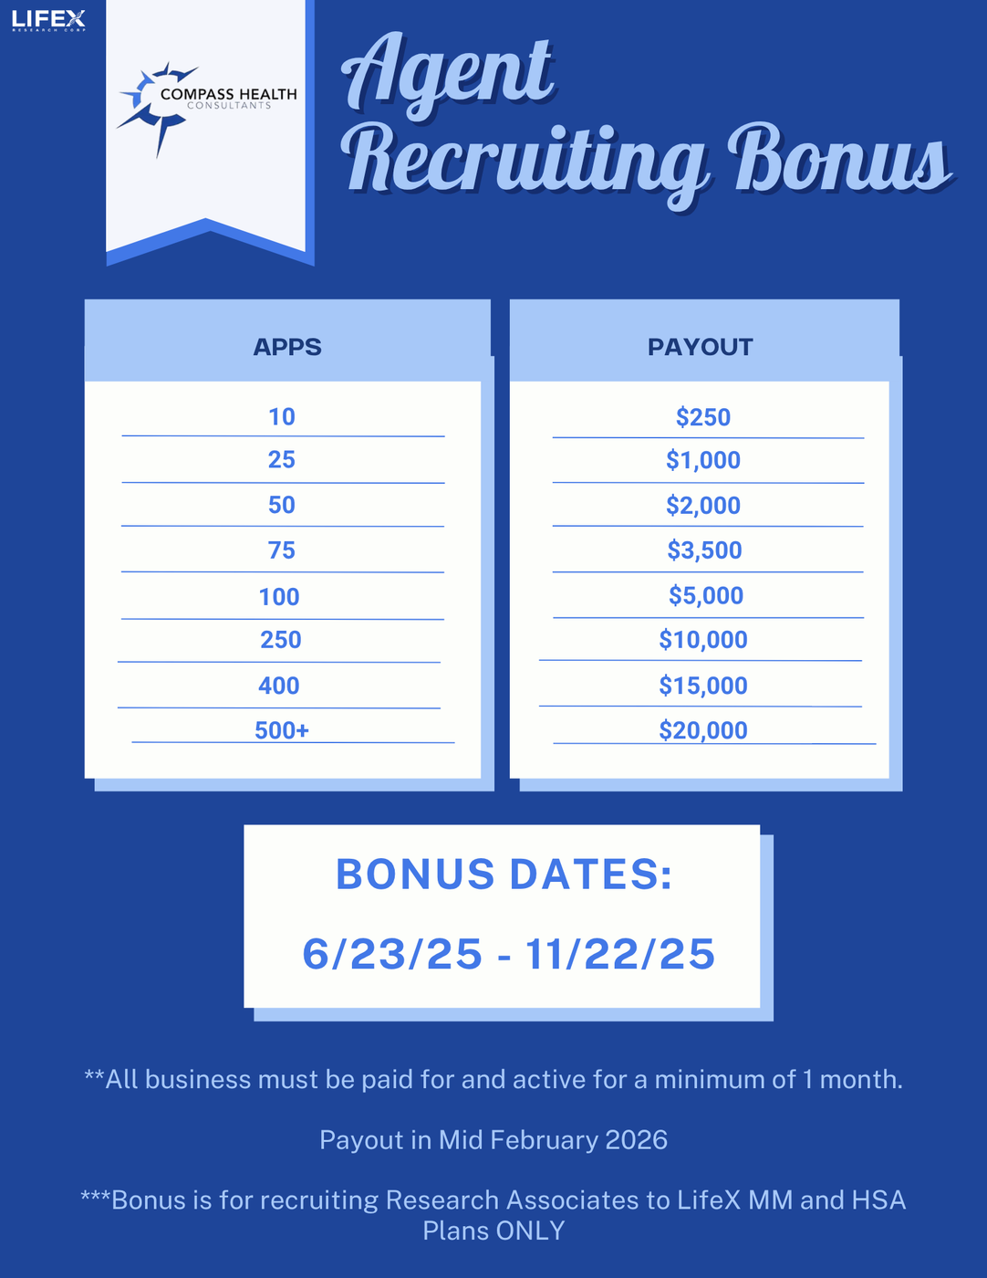
LIFEX BONUS
winners
  Luke E.
  John R.
  Alex S.
  Thomas T.
  Dalton M.
  Michael M.
  Stefanie F.
  Reid D.
  Ronald G.
  Megan W.
125
83
70
66
65
63
59
56
55
52
+ over 200 more winners!

Slide 19
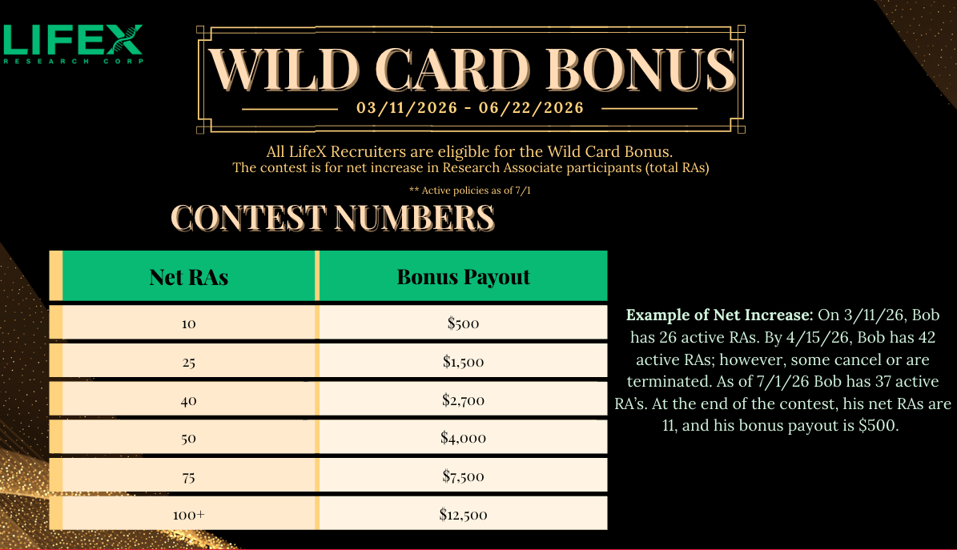

Slide 20






MEGA MULTIPLIER
2ND MEGA MULTIPLIER
1 XGB GROUP WITH 10+ ENROLLED = BONUS X1.25
3 XGB GROUPS OF 10+ ENROLLED = BONUS X1.5
EXAMPLE: $1,500 BONUS = $1,875 WITH MEGA MULTIPLIER
EXAMPLE: $1,500 BONUS = $2,250 WITH 2ND MEGA MULTIPLIER
Super Jackpot Bonus
5+ XGB GROUPS WITH A TOTAL 100+ EMPLOYEES = BONUS X2
EXAMPLE: 100+ LIFEX POLICIES + 5 XGB GROUPS = $25,000 BONUS

Slide 21


Slide 22

PSM New Enrollments Notice of NEW Milliman Suitability Tool
https://discover.ironhealthbenefits.com/suitability/

Slide 23


LESS THAN ONE WEEK UNTIL PUNTA!
If you’re going make sure you check your email and fill out the necessary forms!

Slide 24






Slide 25





QUESTIONS?
COMMENTS?
Next Agency Update:
APRIL 2ND
1PM CST

