Slide 1

JK Agency Updates
Thursday, July 24

Slide 2



ATTENTION NEW AGENTS
SELL YOUR FIRST APPLICATION BY NEXT FRIDAY, AUGUST 1ST & RECEIVE A COMPASS SHIRT* AND $100 LEAD CREDITS!
*MAY BE SUBSTITUTED FOR A $50 CHC STORE CREDIT
Connect with us!
If you’re not receiving CHC emails, please email Mari Krivelow at marketing@chcquotes.com. Text “START” to (314) 742-7842 to receive text messages.
Follow us!

Slide 3

REFERRALS
Our next CHC New Agent Training & Development is August 12th and 13th in Tampa, FL. Send your referrals to recruiting@chcquotes.com, and you could get a $1,000 cash bonus when the new recruit hits their 10th paid application. The new agent must hit the 10th paid application in their first
three months.
*Must have a $25 minimum premium per application
*ACA plans do not qualify

Slide 4

UPCOMING
TRAININGS
Kickstart
July 25, August 15, 29: Foundations
July 28, Aug 18: Elevator Speech & First 5 Seconds
July 29, Aug 19: Expectations & Action Plans
July 30, Aug 20: Show Me the Money
July 31, Aug 21: Handling Objections
August 1, 22: How to Build Your Business
August 14, 28: Attitude is Everything
Team Dials with Q&A
July 29, August 5, 12, 19, 26
New Agent Training
August 12, 13: Tampa
August 26, 27: STL
Thursday Trainings
Dialing for Dollars
July 31: Life Insurance
August 7: Under 65 Products
August 14, 28: JK Agency Updates Call
August 21: Group Insurance
August 23
Medicare
Medicare Minute Wednesday Every Wed Morning
Monday Madness
Agent Support Training
July 28: LifeX
August 4: Prospecting & Sales Psychology
August 11: Back Office / Claim Support
August 18: ACA Certification & Registration
August 25: Bundling the Sale
Every Tuesday at 9am
NEW! LifeX & BHPI Group Webinars
LifeX: Wed / Fri at 11am CST Link on chcagents.com
Keep checking chcagents.com for updates!
**MORE INFORMATION ON CHCAGENTS.COM
Notes:
ADD AUGUST

Slide 5
CHC NEWSLETTER
Managers or other agents please nominate agent of month!
Find the newsletter on chcagents.com ⟶ Resources ⟶ Marketing

Slide 6
AGENT SUPPORT
CHC:
Phone: (636) 561-5739 x3
Email: agentsupport@chcquotes.com
LifeX:
Phone: (307) 452-5055
Email: agentsupport@lifexplans.com
Please do not cc both emails on inquiries as we are assisting both, and this creates double the work for our team.
Be sure to call the correct number for assistance. If you call the wrong line, and you are a call back, this can lead to delay on getting assisted.
Notes:
Elev8 Advanced Agent Training & Conference, St. Louis
September 18-19, 2025
TO QUALIFY TO ATTEND:
Must have been with CHC for 18 months, or less
Must have at least 3 completed sales/apps in Top Broker
COST: $300 per person (can't use marketing money).
CHC is giving a $60 credit for each completed sale/app. in Top Broker to be used toward your training expense (no cash value).
So, for example, if you have 3 apps in Top Broker, your out-of-pocket cost would be $120.
If you have 5 apps in Top Broker, you can attend at no out-of-pocket cost.
*EVENT IS BY INVITATION ONLY
To request an invitation, email: media@chcquotes.com
use "AAT INVITE" as the subject.
Send your:
date of hire
name
email
phone number

Slide 7

UPCOMING EVENTS
ADVANCED AGENT TRAINING
MASTERMIND
September 20, 2025
**INVITE ONLY
(ELEV8 with SWAT): September 18-19, 2025
NASHVILLE CARRIER BLITZ
CHC ANNUAL AWARD TRIP
September 25 - 28
March 19-22, 2026
Contest dates: 1/1/25 - 12/22/25

Slide 8
ELEV8 ADVANCED AGENT TRAINING & CONFERENCE
SEPTEMBER 18-19, 2025
TO QUALIFY TO ATTEND:
  Must have been with CHC for 18 months or les
  Must have at least 3 completed apps/sales in TopBroker
COST: $300/person (No marketing money)
CHC is giving a $60 credit for each completed app/sale in TopBroker to be used toward your training expense (no cash value)
In order for them to count towards your credit, all apps must be entered in TB by August 11, 2025.
Example: with 3 apps in TB, your out of pocket cost would be $120. If you have 5 apps in TB, you can attend at no out of pocket cost.
**Event is invite only. To request an invitation email: Media@chcquotes.com and use “AAT INVITE + Your Name” as the subject
Send Your:
  Date of Hire
  Name
  Email
  Phone Number
Notes:
Elev8 Advanced Agent Training & Conference, St. Louis
September 18-19, 2025
TO QUALIFY TO ATTEND:
Must have been with CHC for 18 months, or less
Must have at least 3 completed sales/apps in Top Broker
COST: $300 per person (can't use marketing money).
CHC is giving a $60 credit for each completed sale/app. in Top Broker to be used toward your training expense (no cash value).
So, for example, if you have 3 apps in Top Broker, your out-of-pocket cost would be $120.
If you have 5 apps in Top Broker, you can attend at no out-of-pocket cost.
*EVENT IS BY INVITATION ONLY
To request an invitation, email: media@chcquotes.com
use "AAT INVITE" as the subject.
Send your:
date of hire
name
email
phone number

Slide 9
AWARD TRIP CONTEST
Rules
  Each application submitted and paid June 1 - Dec 22 2025 you’ll get the amount listed below of Compass Cash towards cost of the trip
  All policies written from Jan 1 - May 31 2025 (Previously written) will be given 50% credit
  Top 15 agents and top 3 leaders (by Compass Cash points) will attend the trip for free** (Free hotel accommodation + $750 towards flights per couple**)
  Leaders credit is ⅓ of their agents credit
Carrier | Compass Cash Per Policy Sold
LifeX | $15
Enroll Prime Iron Health OneShare | $10
AmeriBenefit Flex Benefits MedMutual NCD | $5
Group Health Policies (LEVEL FUNDED PLANS ONLY) | $5 per employee
For those that are NEW agents who’ve submitted their first app after June 1st 2025, all points are DOUBLED!
***Based on ACTUAL BUSINESS, not TopBroker
Notes:
ameribenefit plan
iron health
flex benefit
med mutual
enroll prime
lifex
ncd
oneshare
group
iron health and enroll prime and one share: $10 Compass Cash
lifex: $15 compass cash
everything else except for group: $5 compass cash
group: $5 CC per employee
rules: each application submitted and paid june 1 until 12/22 you will get that amount of compass cash towards the cost of your trip. all policies written from jan 1 - may 31st they will be given 50% credit ($10 with be $5). the top 15 agents and top 3 leaders by compass cash points will go for free. leaders credit equals 1/3 the credit of the agents credit.
CC is redeemable towards the cost of the trip including up to $750 of flight credit
top 15 free hotel accomodation + 750 flight credit per couple
ask amy: drop dead date (when to let us know if they're going on trip) (dad thinks Jan 15)
ON ACTUAL BUSINESS - NOT TB

Slide 10
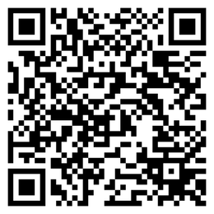
AGENT SUPPORT
We ask that all agents communicate with professionalism and respect so we can work effectively together.
JOIN OUR TEXT THREAD
UPDATES
Text “START” to (314) 742-7842
**You'll get a message saying you subscribed to HST STL LLC - that is Compass Health Consultants legal name, and you'll get texting updates through that new number starting soon.
CHC WOMEN’S COUNCIL
We’re forming a Women’s Council to create space for connection, learning, and leadership. If you’re interested in being part of it, please complete the QR code below. First meeting in August!.

Slide 11
OCTOBER 1 UPDATES
October 1, 2025-January 1, 2026 there will be NO hierarchy changes so we can clean everything up and make sure we’re in the right place!
KEEP YOUR EYES PEALED!
Oneshare and Philadelphia American trainings to come!
UPDATES
PHILADELPHIA AMERICAN BONUS
Number of Apps | Money Earned
1-5 | $250
6-10 | $500
11-15 | $750
16-19 | $1,000
20+ | $2,000
Dates: 8/1 - 9/30

Slide 12

  The deadline for BHPI enrollments is the 15th of the month before the effective date.
  Agents should be sending BHPI enrollment documents to group@themvpplans.com.
  Agents’ questions regarding commission should be directed to their upline manager or LOA. For CHC agents commission schedule is located on the CHC agent website under commissions.
    For all questions about the BHPI plans/enrollment, please go to the website https://www.bhpigroup.com. After reviewing the videos, if you still have questions, please reach out to schedule a call.
  Anthem network is being added
  BHPI Reoccuring Webinar: Wednesdays 4pm CST Link on www.chcagents.com
  1 network under 100 eligible
    2 networks 101-200 eligible
  VL group plans have waiting periods like individual plans

Slide 13


LIFEX AND IRON HEALTH
New CHC agents that have not written business yet are eligible to get a 3 months advance for a 6 month period for LifeX and Iron Health!

Slide 14

Notes:
courtney for major issues in bullet point form - court to speak on during call

Slide 15



Notes:
courtney for major issues in bullet point form - court to speak on during call

Slide 16
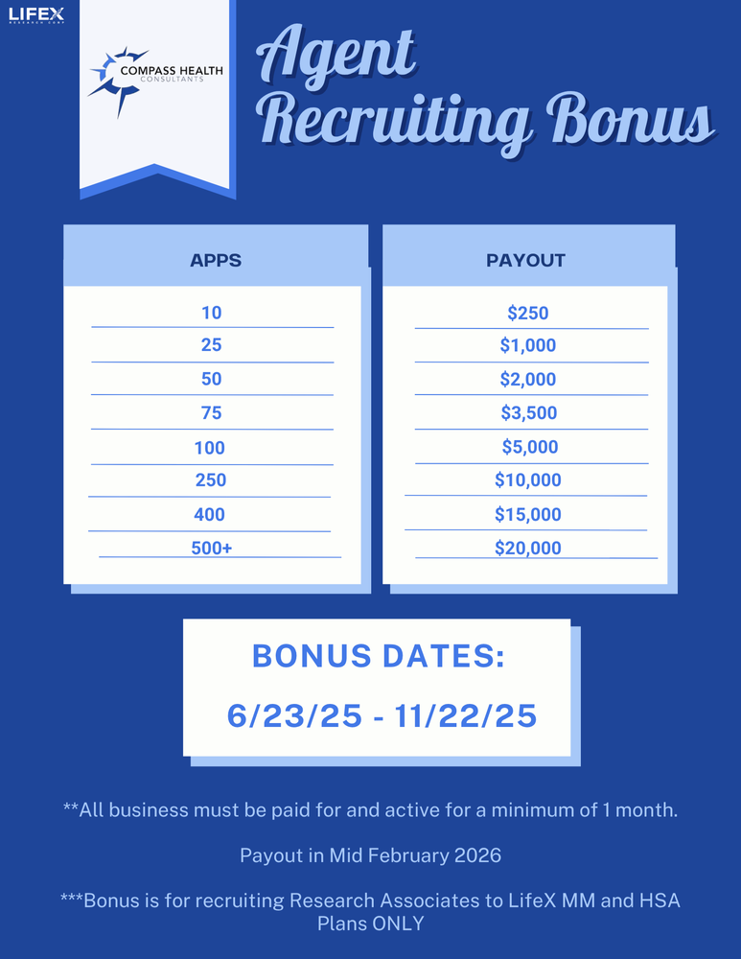

Slide 17



Winners!
Robert Weinstein $400
Darryl Breland $100
Andrew Tournigy $100

Slide 18
UNDERSTANDING GROUP COMP
  Group commissions pay as earned monthly
  Typically, a June 1st effective group would pay 30-45 days after the effective date
  If group doesn’t pay premium until later in the effective month (grace period), comp payment could be delayed even further
  Ex: June 1 effective date group could pay by July 15 or late August

Slide 19



Top 10 Agents July 2025/Submitted
*Only Includes Agency Appointed Carriers
RANK
NAME
# OF APPS
1
2
3
4
5
6
7
8
9
10
Tom Trifaro
Robert Weinstein
Phil Vogt
Trevor Magloire
Christopher Johnson
Janet Rhonehouse
Jennifer Earp
Richard Hyde
John Hughes
Jasmine Garcia
45
27
25
24
24
23
22
21
20
20

Slide 20


CHC corporate office will be CLOSED tomorrow at 1pm CST. Thank you for your understanding.

Slide 21



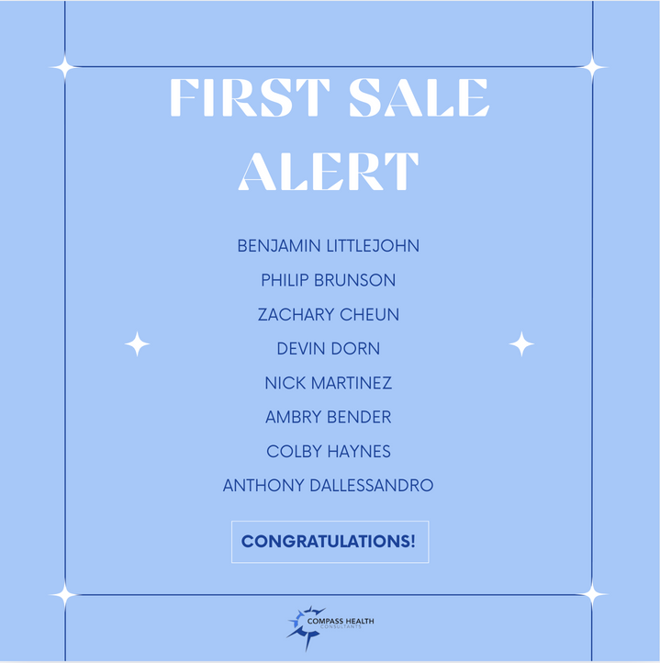
SALE!
Notes:
double check w tanya.
65 new people paid this month. math aint mathin

Slide 22





Questions? Comments?
Next JK Update: Thursday August 14th
Follow us on social media!

