Slide 1


JK Agency Updates
Thursday, September 11

Slide 2



ATTENTION NEW AGENTS
SELL YOUR FIRST APPLICATION BY NEXT FRIDAY, SEPTEMBER 19TH & RECEIVE A COMPASS SHIRT* AND $100 LEAD CREDITS!
*MAY BE SUBSTITUTED FOR A $50 CHC STORE CREDIT
Connect with us!
If you’re not receiving CHC emails, please email Mari Krivelow at marketing@chcquotes.com. Text “START” to (314) 742-7842 to receive text messages.
Follow us!

Slide 3


REFERRALS
Our next CHC New Agent Training & Development is September 16th and 17th in St. Louis, MO. Send your referrals to recruiting@chcquotes.com, and you could get a $1,000 cash bonus when the new recruit hits their 10th paid application. The new agent must hit the 10th paid application in their first
three months.
*Must have a $25 minimum premium per application
*ACA plans do not qualify

Slide 4

UPCOMING
TRAININGS
Kickstart
September 16: Expectations & Action Plans
September 17: Show Me the Money
September18: Handling Objections
September 19: How to Build Your Business
September 12: Foundations
September 15: Elevator Speech & First 5 Seconds
Team Dials with Q&A
September 16, 23, 30
New Agent Training
September 16 & 17: STL
Thursday Trainings
Dialing for Dollars
September 11: JK Agency Updates Call
September 13
Medicare
Monday Madness
Medicare Minute Wednesday Every Wed Morning
September 15: Approaching Small Businesses
September 22: Medicare
Agent Support Training
Every Tuesday at 9am
LifeX & BHPI Group Webinars
LifeX: Wed / Fri at 11am CST Link on chcagents.com
BHPI: Wed 4pm CST Link on chcagents.com
Keep checking chcagents.com for updates!
**MORE INFORMATION ON CHCAGENTS.COM
Notes:
ADD AUGUST

Slide 5

HOW TO CHANGE YOUR CHC EMAIL PW
Step 1
Log in to apps.rackspace.com
Step 2
Click the 3 lines in the upper right hand corner
Step 3
Click Settings
Step 4
Click Security, then “Change it Now”
**If you still receive spam DO. NOT. FORWARD!! Please report it or you can send a screenshot. Forwarding enables them more access. Thank you for your understanding.

Slide 6

AGENT SUPPORT
CHC:
Phone: (636) 561-5739 x3
Email: agentsupport@chcquotes.com
LifeX:
Phone: (307) 452-5055
Email: agentsupport@lifexplans.com
Please do not cc both emails on inquiries as we are assisting both, and this creates double the work for our team.
Be sure to call the correct number for assistance. If you call the wrong line, and you are a call back, this can lead to delay on getting assisted.
Notes:
Elev8 Advanced Agent Training & Conference, St. Louis
September 18-19, 2025
TO QUALIFY TO ATTEND:
Must have been with CHC for 18 months, or less
Must have at least 3 completed sales/apps in Top Broker
COST: $300 per person (can't use marketing money).
CHC is giving a $60 credit for each completed sale/app. in Top Broker to be used toward your training expense (no cash value).
So, for example, if you have 3 apps in Top Broker, your out-of-pocket cost would be $120.
If you have 5 apps in Top Broker, you can attend at no out-of-pocket cost.
*EVENT IS BY INVITATION ONLY
To request an invitation, email: media@chcquotes.com
use "AAT INVITE" as the subject.
Send your:
date of hire
name
email
phone number

Slide 7
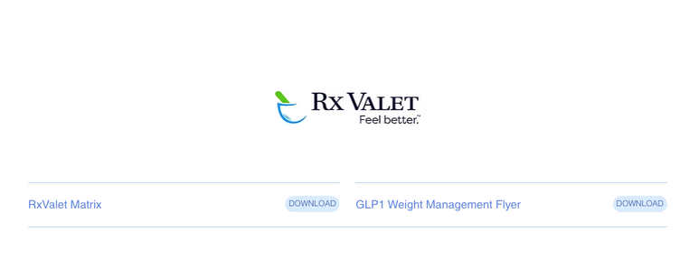

Slide 8

CONTRACTING UPDATES
No hierarchy changes will be processed in Q3 Oct 1- Jan 1, 2026.
VBA: Now contracted through CHC
Manhattan Life & Best One contracting is now available! Use the additional request link to sign up today.
Current Projects
Full carrier directory including ACA (Q4 2025)
Agent completed carrier appointments. We will now know the carriers you are appointed with under CHC. (Q1 2026)
Aetna is NOW CLOSED for contracting!
ACA - Common Ground is on hold until further notice
Ameritas contracting is still in progress
Notes:
Elev8 Advanced Agent Training & Conference, St. Louis
September 18-19, 2025
TO QUALIFY TO ATTEND:
Must have been with CHC for 18 months, or less
Must have at least 3 completed sales/apps in Top Broker
COST: $300 per person (can't use marketing money).
CHC is giving a $60 credit for each completed sale/app. in Top Broker to be used toward your training expense (no cash value).
So, for example, if you have 3 apps in Top Broker, your out-of-pocket cost would be $120.
If you have 5 apps in Top Broker, you can attend at no out-of-pocket cost.
*EVENT IS BY INVITATION ONLY
To request an invitation, email: media@chcquotes.com
use "AAT INVITE" as the subject.
Send your:
date of hire
name
email
phone number

Slide 9

Your FIRST STOP!!
When you have any questions whether it’s about commissions, how to contract, Punta Cana trip, brochures for carriers, or more - go to www.chcagents.com FIRST! We have SO much information, please use this resource we provide. Especially the FAQ page located in the resources, important links tab!
For a full walkthrough navigate to our video library and click Agent Support for a full video walkthrough.
chcagents.com

Slide 10

UPCOMING EVENTS
ADVANCED AGENT TRAINING
MASTERMIND
September 20, 2025
**INVITE ONLY
(ELEV8 with SWAT): September 18-19, 2025
NASHVILLE CARRIER BLITZ
CHC ANNUAL AWARD TRIP
September 25 - 28
March 19-22, 2026
Contest dates: 1/1/25 - 12/22/25

Slide 11
ELEV8 ADVANCED AGENT TRAINING & CONFERENCE
SEPTEMBER 18-19, 2025
TO QUALIFY TO ATTEND:
  Must have been with CHC for 18 months or les
  Must have at least 3 completed apps/sales in TopBroker
COST: $300/person (No marketing money)
CHC is giving a $60 credit for each completed app/sale in TopBroker to be used toward your training expense (no cash value)
In order for them to count towards your credit, all apps must be entered in TB by August 11, 2025.
Example: with 3 apps in TB, your out of pocket cost would be $120. If you have 5 apps in TB, you can attend at no out of pocket cost.
**Event is invite only. To request an invitation email: Media@chcquotes.com and use “AAT INVITE + Your Name” as the subject
Send Your:
  Date of Hire
  Name
  Email
  Phone Number
Notes:
Elev8 Advanced Agent Training & Conference, St. Louis
September 18-19, 2025
TO QUALIFY TO ATTEND:
Must have been with CHC for 18 months, or less
Must have at least 3 completed sales/apps in Top Broker
COST: $300 per person (can't use marketing money).
CHC is giving a $60 credit for each completed sale/app. in Top Broker to be used toward your training expense (no cash value).
So, for example, if you have 3 apps in Top Broker, your out-of-pocket cost would be $120.
If you have 5 apps in Top Broker, you can attend at no out-of-pocket cost.
*EVENT IS BY INVITATION ONLY
To request an invitation, email: media@chcquotes.com
use "AAT INVITE" as the subject.
Send your:
date of hire
name
email
phone number

Slide 12
AWARD TRIP CONTEST
Rules
  Each application submitted and paid June 1 - Dec 22 2025 you’ll get the amount listed below of Travel Tokens towards cost of the trip
  All policies written from Jan 1 - May 31 2025 (Previously written) will be given 50% credit
  Top 15 agents and top 3 leaders (by Travel Tokens points) will attend the trip for free** (Free hotel accommodation + $750 towards flights per couple**)
  Leaders credit is ⅓ of their agents credit
Carrier | Compass Cash Per Policy Sold
LifeX | $15
Enroll Prime PSM OneShare | $10
AmeriBenefit Flex Benefits MedMutual NCD | $5
Group Health Policies (LEVEL FUNDED PLANS ONLY) | $5 per employee
For those that are NEW agents who’s first payroll was after June 1st 2025, all points are DOUBLED!
***Based on ACTUAL BUSINESS, not TopBroker
Notes:
Breathless in Punta Cana
GROUP TRACKING: Need to know effective dates of group
**Work with Brandie - she'll work with payroll to find out whats getting paid. Morrissey will help us.

Slide 13


Slide 14



CHC WOMENS COUNCIL
NEXT MEETING
**DATE CHANGE:
Friday, September 12 at 10am CST
Focus on Marketing
We hope to see you there!
**If you’re not in the slack and wish to be, send an email to marketing@chcquotes.com!

Slide 15
OCTOBER 1 UPDATES
October 1, 2025-January 1, 2026 there will be NO hierarchy changes so we can clean everything up and make sure we’re in the right place!
KEEP YOUR EYES PEALED!
Oneshare and Philadelphia American trainings to come!
UPDATES
PHILADELPHIA AMERICAN BONUS
Number of Apps | Money Earned
1-5 | $250
6-10 | $500
11-15 | $750
16-19 | $1,000
20+ | $2,000
TOP 5
  Kyle Constant: 6
  Rachid Eloudiyi: 4
  Chrystal Constant: 3
  Chelsea Criswell: 3
  Gregory Rodrigues: 2
Dates: 8/1 - 9/30

Slide 16



Name change
coming SOON!
  The deadline for BHPI enrollments is the 15th of the month before the effective date.
  Agents should be sending BHPI enrollment documents to group@themvpplans.com.
  Agents’ questions regarding commission should be directed to their upline manager or LOA. For CHC agents commission schedule is located on the CHC agent website under commissions.
    For all questions about the BHPI plans/enrollment, please go to the website https://www.bhpigroup.com. After reviewing the videos, if you still have questions, please reach out to schedule a call.
  Anthem network is being added
  BHPI Reoccuring Webinar: Wednesdays 4pm CST Link on www.chcagents.com
  1 network under 100 ENROLLED
    2 networks 101-200 ENROLLED
  VL group plans have waiting periods like individual plans

Slide 17


Cigna is NOW Available!
Notes:
courtney for major issues in bullet point form - court to speak on during call

Slide 18


SHORT TERM MEDICAL IS BACK
Notes:
courtney for major issues in bullet point form - court to speak on during call

Slide 19



Notes:
courtney for major issues in bullet point form - court to speak on during call

Slide 20
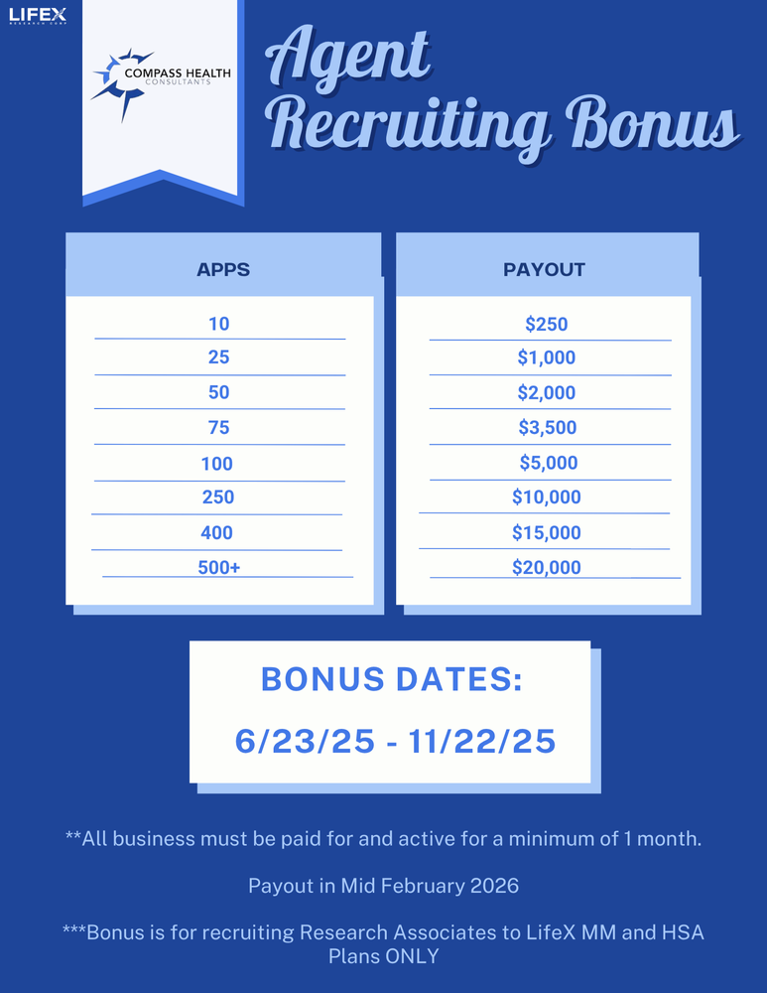
TOP 5
  Tom Trifaro: 25 Apps
  John Roberts: 24 Apps
  Matthew Caselli: 20 Apps
  David Stoner: 19 Apps
  Alex Scardaccione: 18 Apps

Slide 21

OUR LOGO IS NOW PATENTED
What does this mean?
In the next few weeks you will be getting an email with the NEW CHC Patented Logo. Please ONLY use THAT logo moving forward.
Thank you!

Slide 22



Top 10 Agents September 2025/Submitted
*Only Includes Agency Appointed Carriers
RANK
NAME
# OF APPS
1
2
3
4
5
6
7
8
9
10
Brent Miles
Christopher Johnson
Edward Meredith
Savannah Clark
Thomas Trifaro
Phil Vogt
Chip Dobson
Dan Crittenden
Richard Hyde
Trevor Magloire
52
38
30
28
24
22
17
16
15
14

Slide 23




SALE!
Notes:
double check w tanya.
65 new people paid this month. math aint mathin

Slide 24


TODAY IS A DAY OF REMEMBRANCE AND REFLECTION.
WE WILL NEVER FORGET.

Slide 25





Questions? Comments?
Next JK Update: Thursday October 9
Follow us on social media!

