Slide 1


JK Agency Updates
Thursday, April 10th
1PM CST
Zoom Meeting Link
https://zoom.us/j/3738421209

Slide 2







ATTENTION NEW AGENTS
Sell your first application by next Friday, April 18th & receive a Compass shirt* and $100 lead credits!
*May be substituted for a $50 CHC store credit
Email mkrivelow@chcquotes.com to receive
Connect with us!
If you’re not receiving CHC communications (email and texts), please email Mari Krivelow at mkrivelow@chcquotes.com
Follow us!

Slide 3




Do you know someone looking for a new career?
Our next CHC New Agent Training & Development is April 22 & 23rd in STL. Send your referrals to Liz Wardrop, ewardrop@chcquotes.com, and you could get a $1,000 cash bonus when the new recruit hits their 10th paid application. The new agent must hit the 10th paid application in their first
three months.
*Must have a $25 minimum premium per application
*ACA plans do not qualify

Slide 4

UPCOMING
TRAININGS
Kickstart
Team Dials with Q&A
April 15, 29 - Expectations & Action Plans
April 16, 30 - Show Me the Money
April 17 - Handling Objections
April 18 - How to Build Your Business
April 25 - Attitude is Everything
April 28 - Elevator Speech & First 5 Seconds
April 14, 24 - Foundations
April 15, 22, 29
New Agent Training
April 22 & 23: STL
Dialing for Dollars
Thursday Trainings
April 19
April 10: JK Agency Updates Call
April 17: Under 65 Products
April 24: JK Agency Updates Call
Medicare
Medicare Minute Wednesday Every Wed Morning
NEW! Agent Support Training
Monday Madness
April 14: Foundation Mental Wellness
April 21: FlexBenefits
April 28: AmeriBenefit
Every Tuesday at 9am
NEW! LifeX Webinars
April 11, more to come!
**MORE INFORMATION ON CHCAGENTS.COM

Slide 5




Affiliate Site NEW UPDATE
Contact mkrivelow@chcquotes.com to get your own webpage!
You can now integrate your website with TopBroker!!!
GET FREE (LIMITED TIME): $40 lead credit until May 5

Slide 6

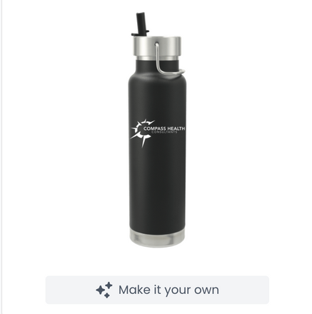

MORE SWAG
You can now buy CUSTOMIZED CHC Swag
Visit chcagents.com and scroll to the bottom!
https://compass-swag-store.getgivee.com/products

Slide 7


Join the Chc Agents Channel
https://compasshealth-poc4420.slack.com/archives/C08LQLDU0BH

Slide 8


For more info, please contact Holly Adkison at Hadkison@chcquotes.com or call 636-280-9229

Slide 9




Iron Health
Gigcare
Discussion
Notes:
courtney for major issues in bullet point form - court to speak on during call

Slide 10


AGENT SUPPORT
Please wait a MINIMUM of 24-48 hours before sending the same inquiry to agent support.
Please do NOT to cc: clients on agent support
Email agentsupport@lifexplans.com for LifeX inquiries
We’ve added an Agent Support Updates Call every Tuesday morning at 9am CST on a NEW LINK. Please reference chcagents.com. INVITE YOUR DOWNLINES!
If you’re not there by 9:05, you will not be let in to the training. You can find the recordings on chcagents.com in the video library!

Slide 11



LIFEX WEBINARS WILL BE ON CHCAGENTS.COM CALENDAR
FIND MORE INFORMATION AND ALL PLAN DOCUMENTS ON
LIFEXPLANS.COM
**Sign in and have access to all documents
Notes:
courtney for major issues in bullet point form - court to speak on during call

Slide 12

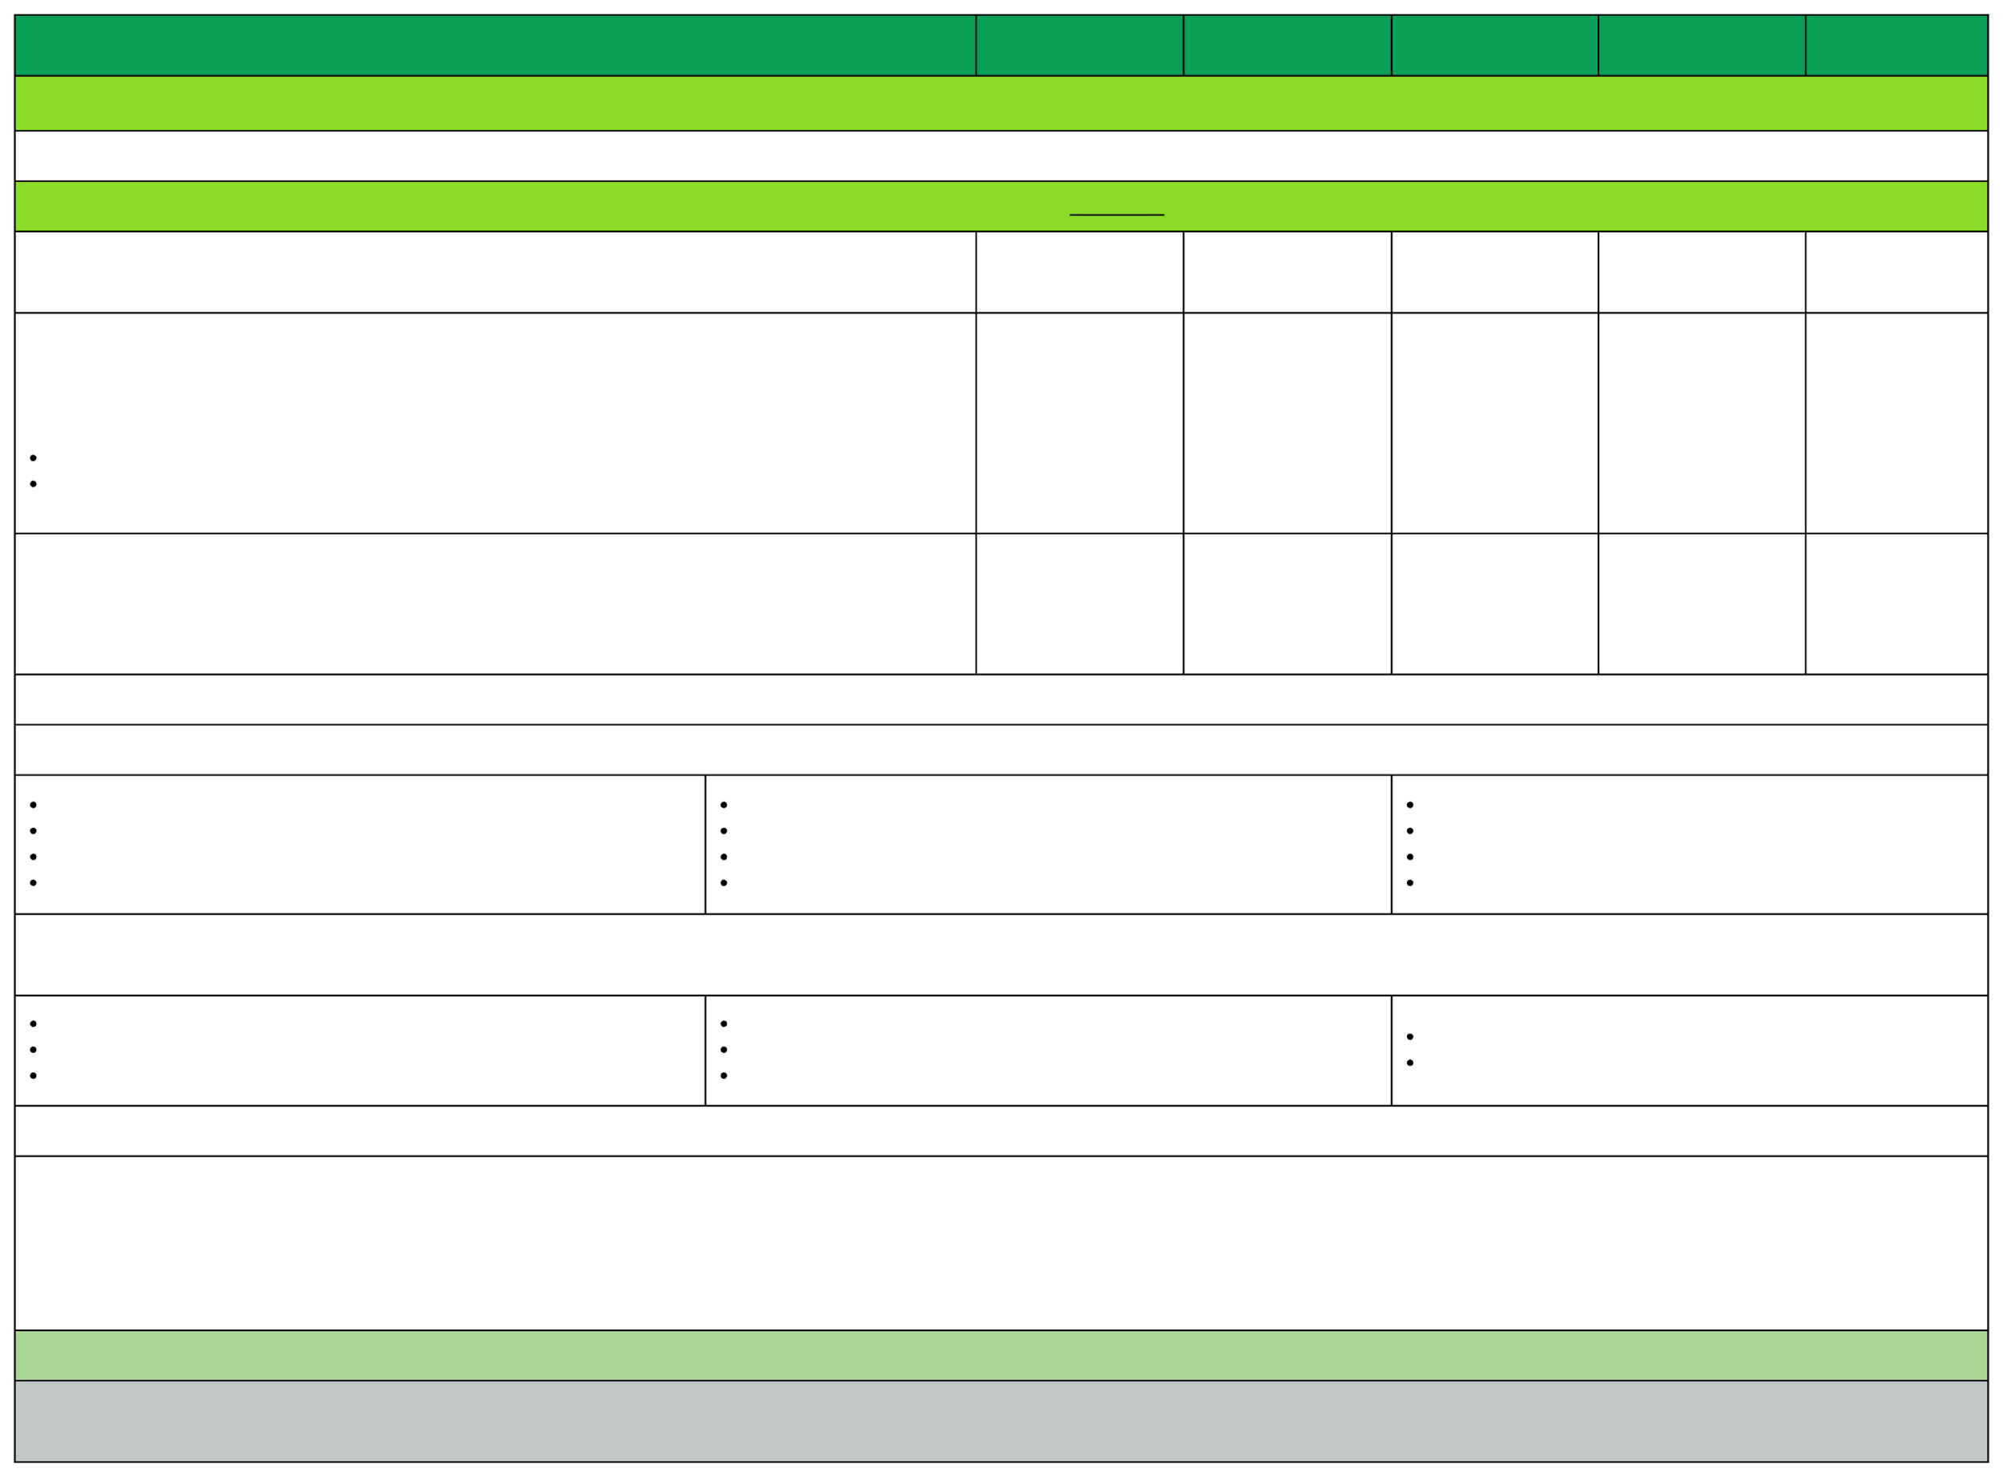
Plan Comparison: Summary of Benefits & Coverage
Rates effective as of January 1, 2025
PLAN
Payment for Services
VL $250
VL $500
VL $750
VL $1,000
VL $1,500
In-network Provider: The provider network is shown on your I.D. card. For help in locating in-network providers, click here.
Maximum Annual Benefit
See Services
Performed
See Services Performed
See Services Performed
See Services Performed
See Services Performed
Deductible (The amount the Covered Person pays each benefit year for Covered Services before the
Coinsurance is payable.)
$250 $500
$500 $1,000
$750 $1,500
$1,000 $2,000
$1,500 $3,000
Individual
Family
Out-of-Pocket Maximun (For member accumulated deductible and copays (Individual/Family) Out of Pocket – Maximum for services beyond the plan visit limits
$9,200 $18,400
Unlimited
$9,200 $18,400
Unlimited
$9,200 $18,400
Unlimited
$9,200 $18,400 Unlimited
$9,200 $18,400
Unlimited
Copays: Please note that after your deductible has been met, you will still be responsible for paying copayments for your medical services. Other Covered Services (Limitations may apply to these services. This isn’t a complete list. Please see your plan document.)
Annual Lab/X-Ray Tests
Annual Pap Smear/Mammogram
Cancer Screenings
Colonoscopies
Diabetic Supply
Immunizations
Other Preventative Screenings
Precision Rx (Prescriptions)
Telemedicine (including Mental Health Services) Urgent Care and Office Visits Well Baby Care Wellness Visits
Services Your Plan Generally Does NOT Cover (Check your policy or plan document for more information and a list of any other excluded services.)
Acupuncture
Children’s Dental Check-Up
Children’s Glasses
Children’s Eye Exam
Dialysis
Biofeedback
Substance Abuse Services
Organ Transplant Services
Services may require preauthorization. Failure to obtain preauthorization will result in denial of benefits. Precertification
Precertification is required for all in-hospital admissions, imaging (CT/PET/MRI/MRA), home health, skilled nursing, hospice, DME (over $500), chemotherapy/radiation, sleep studies, prosthetics/orthotics,
therapies (chiropractic, cardiac, PT/OT/ST), and outpatient surgery. Please refer to the plan document for a complete list of all services that require precertification under your plan. A 50% (up to $2,500)
penalty will apply for not obtaining precertification.
Emergencies are covered but do require authorization/certification within 48 hours. This illustration describes the plan in an easily understood manner and is presented as a matter of general information only.
The contents are not to be accepted or construed as a substitute for the provisions of the plan document or summary plan description, which contains more exact terms and detailed provisions of the plan, and
it is not to be considered a policy of insurance.
Notes:
courtney for major issues in bullet point form - court to speak on during call

Slide 13

LIFE DIVISION

Slide 14


CHC Finance Department
PAYCOR
We’ve started using this software program for our direct deposits. They will come from “HST STL LLC”
In EAgent Center there are NO direct deposits shown, please see those in PAYCOR.

Slide 15

Commissions for ACA are now being deposited by "Effective Insurance Commission"

Slide 16

CHC Contracting Department
Hiring Managers: https://wkf.ms/4cErFQa Request invitation to contract your recruit with CHC
CHC Contracted Agents: CHC Additional Carrier Requests
Link: https://forms.monday.com/forms/9508297440e8ac95cfedbacaeebe7896?r-use1
CHC Contracting Staff: Tanya Mosley & Mimi Crisostomo
Emails: contracting@chcquotes.com contracting@startworktoday.careers
Notes:
add med mutual winners
take med mutual off they need to other links

Slide 17

CHC Contracting Department
  Request LifeX from the Additional Carrier Link, you will need your upline’s LifeX Agent ID
  Please allow a full 2 business days to recieve your testing certification email from KMG. Please do not submit more than once
  If it has been more than 2 full business days, email CHC contracting at contracting@chcquotes.com
  LifeX Welcome Emails will come from support@kmg-services.com, with a Subject Line: Dedicated Enrollment Platform
Notes:
add med mutual winners
take med mutual off they need to other links

Slide 18



Top 10 Agents April 2025/Submitted
*Only Includes Agency Appointed Carriers
RANK
NAME
# OF APPS
1
2
3
4
5
6
7
8
9
10
Jeannine Shoemann
Stefanie Fishman
Christopher Puccio
Brandon Halbert
Tom Trifaro
Al Harmon
Sue Weick
Phil Vogt
Richard Hyde
Diane Kimbro
35
34
28
25
23
21
15
14
13
13
Notes:
double check numbers

Slide 19

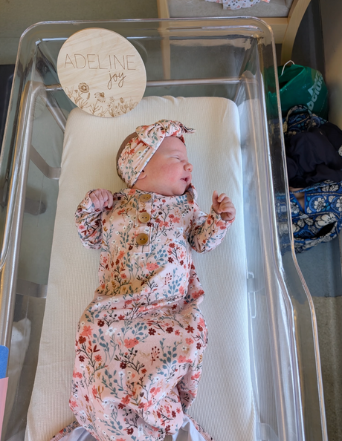

Newest Additions
Congrats Keith Cheverie for welcoming this bundle of joy to the family!
Adeline Joy Cheverie
April 6, 2025
Congrats Bella Rodriquez for becoming an aunt to this beauty.
Eliana Michele Rosales

Slide 20



CHC Recruiting Deparment
Department Request
We need MORE reviews! On Indeed, tied to Glassdoor and on Google Reviews!
Please use the links below!
https://g.page/r/CdxIgotEXxzPEBk/review
https://www.indeed.com/cmp/Compass-Health-Consultants/reviews
Notes:
add next week

Slide 21





SALE!
Notes:
double check w tanya.
65 new people paid this month. math aint mathin

Slide 22


JK Call PPTX will no longer be sent via email. To find the powerpoint slides from JK Calls visit chcagents.com video library and click the JK Agency Call Slides Menu Button

Slide 23





Questions? Comments?
Next JK Update: Thursday April 24th
Follow us on social media!

