Slide 1




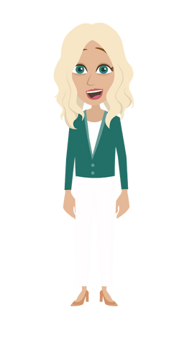



Marketing Yourself
WITH MARI KRIVELOW, LIZZY BENNE, & CALEB THE COMPASS
Notes:
Social Media
Google My Business (How to set up)
Facebook and Insta Business and how to connect the two

Slide 2




MOST
IMPORTANT
01
02
03
01
ESTABLISHING CREDIBILITY
BUILDING TRUST
STAYING CONSISTENT
ESTABLISHING CREDIBILITY

Slide 3






Social Media
HOW CAN
WE HELP YOU?
Flyers
Affiliate Site
Compliancy

Slide 4


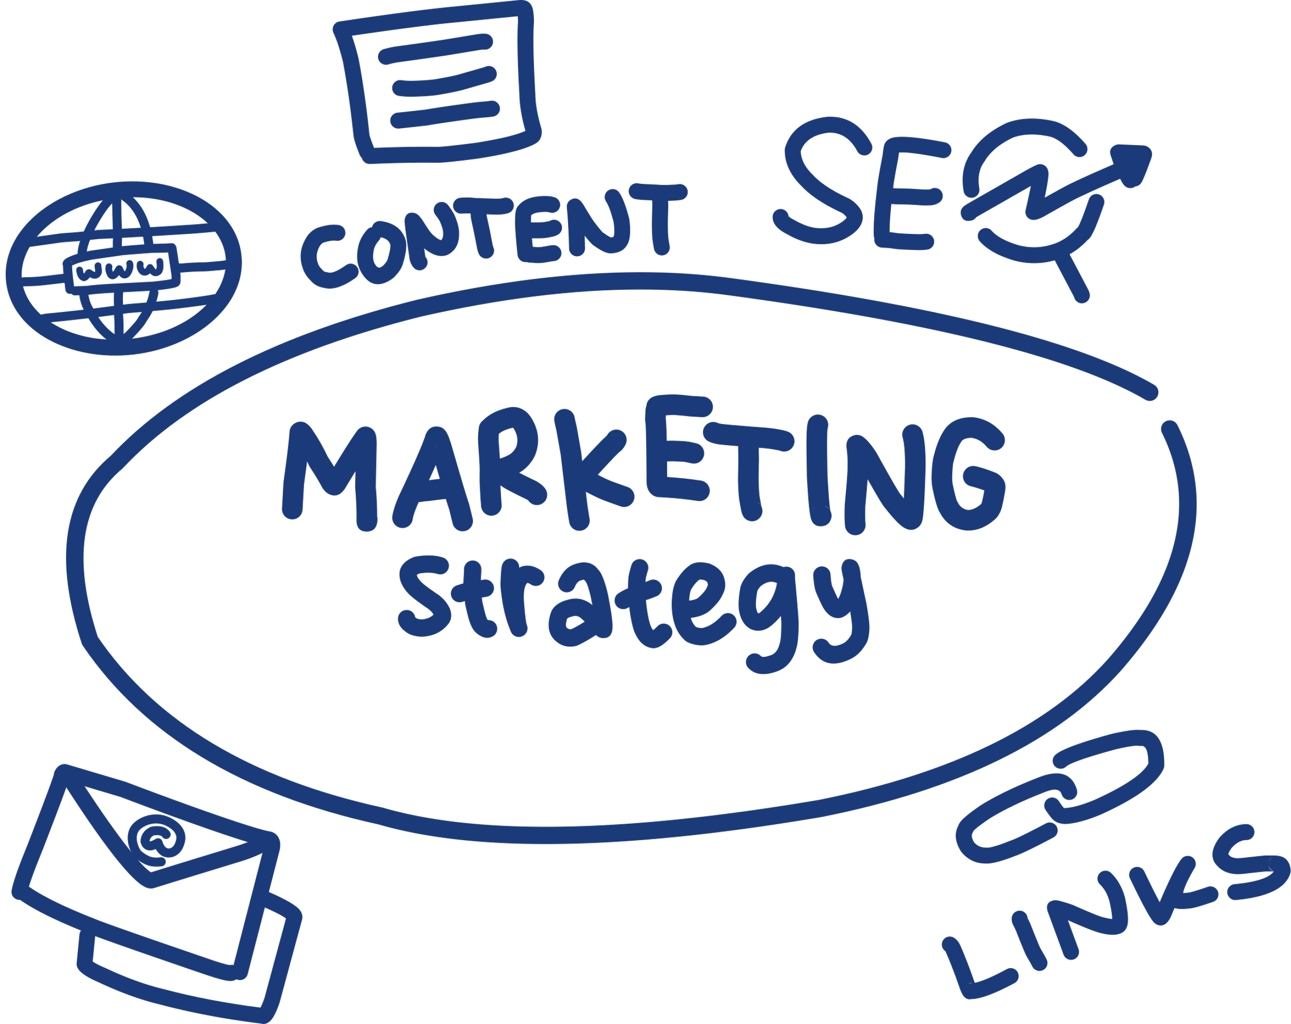

Why Should I Care?
People don’t buy insurance policies, they buy peace of mind from YOU, a person.
By building your own brand, you can increase business with referrals and repeat business.
In today’s world (a digital one), your first impression often speaks even before YOU do!
People buy from those they TRUST!

Slide 5

Let’s talk: Unique Value Propostion (UVP)
Answer the question “Why should I choose you over another agent?”
Focus on the benefit to the client
Use: “I help (target audience) achieve (result) through (your own approach)”
Example: If they’re a parent, “I help new parents protect their family’s future through customized life insurance solutions”
Notes:
$40 lead credit for limited time (until May 5)

Slide 6



First Impressions Matter
Professionalism is IMPORTANT!!
If you have an affiliate site, a business card with a headshot, or any other media make sure your picture is professional.
In your email, include a signature with your name, title, contact information, and any important links.
Socials: consistent brand voice and imagery, have a friendly bio

Slide 7




Building a Personal Brand Online
Q: “How can I stand out in the digital world”
A: “Promote your personal brand/voice on your socials!”
Linkedin: Demonstrate experience that reflects your value
Facebook & Instagram: Post content that reflects your personality while remaining professional
Content Strategy: Post a mix of educational, personal, and client-focused posts
Examples:
Educational: Insurance Updates, FAQs
Personal: Community Involvement, Family
Client-Focused: Testimonials and stories

Slide 8





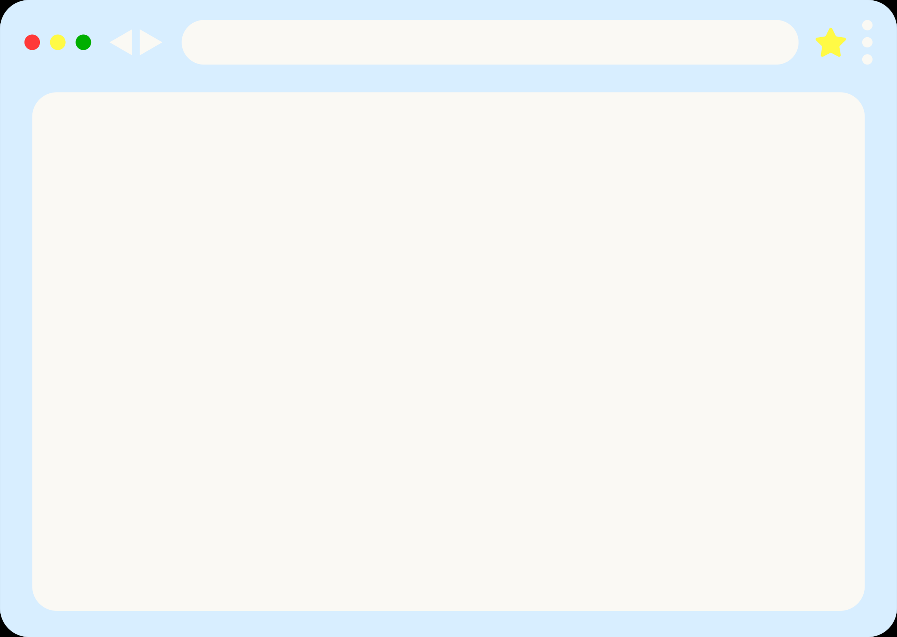





Google Business
Business.google.com
Click “Get Started“
Create profile: business details, service area, business hours, photos, and more!
People can see your business as well as post reviews for you on Google!

Slide 9



Instagram & FB Business Pages
Don’t forget we are here to help! Take a pic☺️📸
Facebook
Instagram
  Log into Facebook (use your personal account).
  On the left side, click Pages → then click Create New Page.
  Fill in basics:
  Page Name (usually your business name)
  Category (ex: "Bakery," "Clothing Store")
  Description (short about your business).
  Click Create Page.
  Add Profile Picture (like your logo) and Cover Photo (a nice banner image).
  Add your business info: hours, location, phone number, website.
  Done ✅ — you now have a Facebook Business Page.
  Download Instagram app (or open Instagram.com).
  Sign up or log in with your personal account.
  Go to your profile → tap three lines (menu) → tap Settings & Privacy.
  Scroll down and select Account type and tools → then Switch to professional account.
  Choose Business (not "Creator").
  Add your Business Category (ex: "Coffee Shop") and contact info.
  Done ✅ — your Instagram is now a Business account.
  It’s best to link Instagram & Facebook:
  On your Facebook Page, go to Settings → Linked Accounts → Connect Instagram.
This way, when you post on one, you can share it to the other automatically.
Notes:
SPLIT

Slide 10


Social Media & Email
Use your content to build trust and recognition with your audience.
You can write short blog posts or videos answering FAQs to get your face out there and recognizable.
Utilize email and text marketing. Stay top of their mind with newsletters, birthdays (personal touch), policy check-ins, and reminders.
Consistency is key
  Use the same headshot, logo, imagery, and tone on all posts, business flyers, and emails
  Make sure your conversations match with your online branding and voice
Facts tell, stories sell
Stay relevant: holidays, current events, etc.

Slide 11
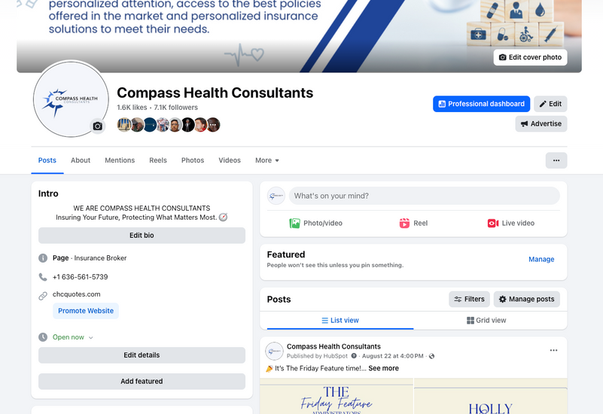
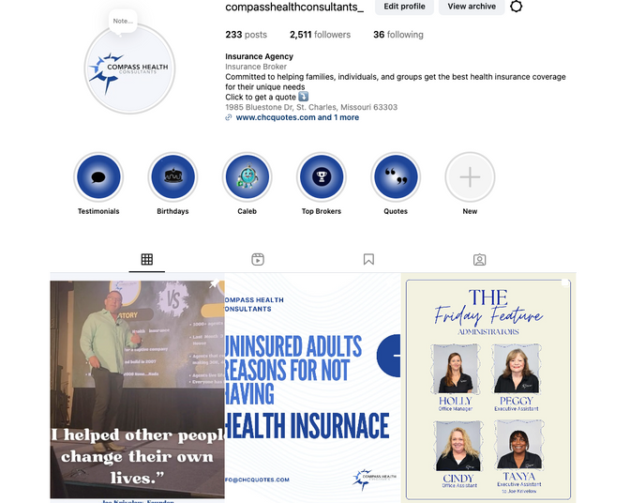
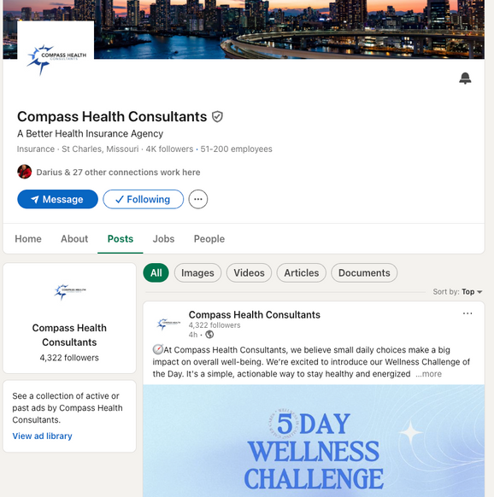







Social Media
Facebook
Instagram
LinkedIn
pages, personal profiles, groups, reels, stories, posts, lives
posts, stories, reel, carousel, lives
linkedin: events, posts, stories, messaging, lives
Pages: scroll to monatise, not just scrolling. photo: friendly and inviting, same on all platforms.
IG: highlight reel full of client reviews

Slide 12






Social Media
LinkedIn & Facebook
Create a background photo that is intriguing, up to date
Instagram, LinkedIn, & Facebook
Public profiles
Bio: Clearly state what you do and how people can reach you
Pin posts: Example, “Start Here” or reviews. Headshot and reintroduce who and how I help, what I do, etc.
Youtube
Tiktok
Podcast
Shorts, lives, posts, podcasts
Video/slideshow photo posts, stories, lives
Posts can be uploaded as visual for YT and shared snippets as reels on IG, FB, TT

Slide 13

No Social Media? No Problem.
Utilize networking by attending community events, talking with friends, or even putting flyers up around your town!
Give our MEMORABLE business cards or promotional items (all of which are available on www.chcagents.com)

Slide 14

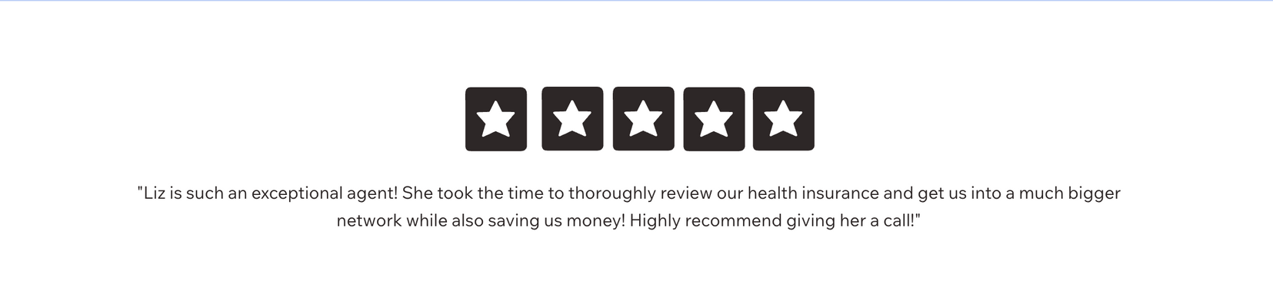
Ask For Reviews
AND REFERRALS!
Make it easy for them to share their amazing experience with others.
*You can post it on social media or share it with CHC and we can post it! We love sharing how amazing our agents are!
Utilize the tool on the bottom of your affiliate site: Review Us

Slide 15

Marketing Yourself: Tools
Canva
Calendly
Zoom
Social Media Scheduling
Excel / Google Sheets
CHC Podcast Room

Slide 16
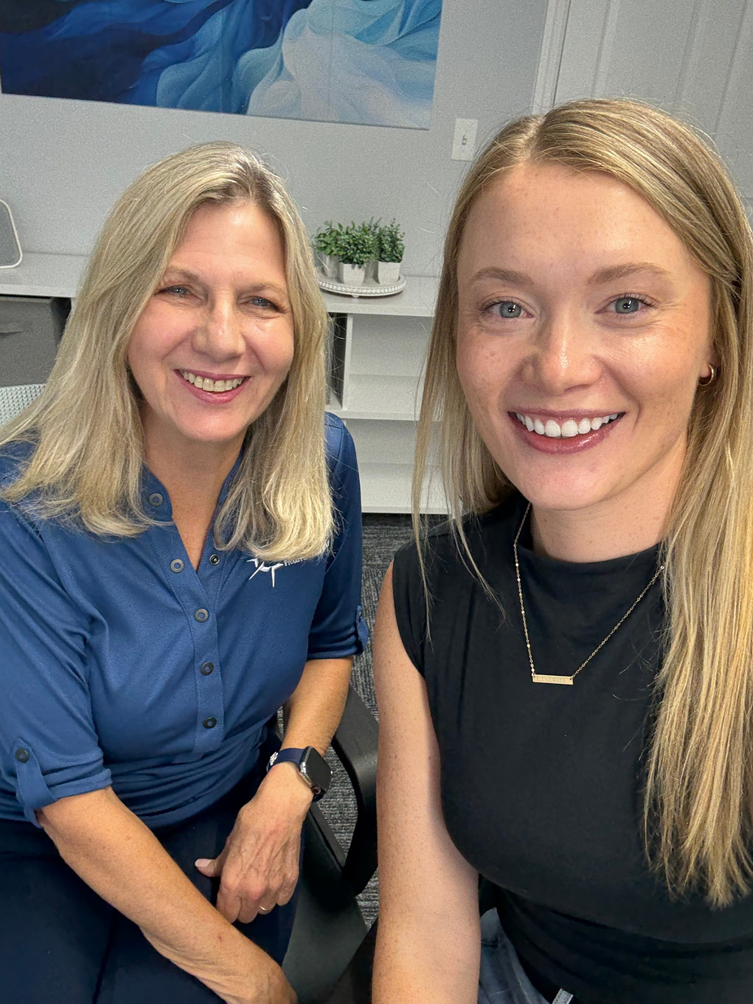
Podcast Room
Privacy
Microphones
Headphones
Book a time
Email Cindy, Amy, or Holly

Slide 17



ACTION PLAN! PICK AT LEAST ONE OF THE BELOW TO DO THIS WEEK!
  Update your social media bios
  Set up a Google Business page
  Ask 2 happy clients to leave a review
  Get an affiliate site
  Create a business social media account
  Post on a social media account
*Do at least 1 thing a week to promote yourself!

Slide 18

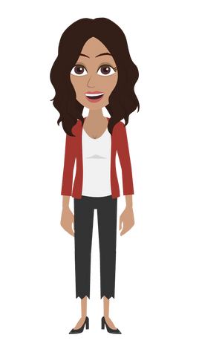
Want more information? Email marketing@chcquotes.com
You’re not alone, we’ve got you covered!

