Slide 1


Agency
Updates
Thursday, April 16, 2026

Slide 2


attention
new
agents
Sell your FIRST application by next Friday, April 24th & receive a CHC shirt** and $100 lead credits!
**MAY BE SUBSTITUTED FOR A $50 CHC STORE CREDIT

Slide 3


CONNECT
WITH CHC!
If you’re not receiving CHC emails, please email marketing@chcquotes.com.
Text “START” to (314) 742-7842 to receive text messages!
Follow us!

Slide 4

Upcoming
Trainings
Kickstart
Dialing for Dollars
First week of the month
April 18 at 10am CST
Medicare
Thursday Trainings
Medicare Minute Wednesday Every Wed Morning 7:30am CST
April 23: Products Under 65 Training
April 30: Agency Updates Call
Agent Support Training
Every Tuesday at 9am CST
Team Dials with Q&A
Life Insurance Training
Tuesday’s at 5pm CST
Every Thursday at 3pm CST
New Agent Training
LifeX & XGB Group Webinars
April 28 & 29: STL, MO
LifeX: Wed / Fri at 11am CST **Friday’s will be Q&A
XGB: Wed 4pm CST
**Full information on chcagents.com

Slide 5


Email
Spam 101
  ALWAYS CHECK THE SENDER EMAIL
  NEVER FORWARD THE MESSAGE
  DON’T REPLY OR ENGAGE
  JUST REPORT IT, THEN DELETE IT

Slide 6




Advanced Agent Training
NEXT WEEKEND: FRIDAY APRIL 24th - SATURDAY APRIL 25th
IN PERSON ONLY!

Slide 7

CHC WOMENS COUNCIL
APRIL MEETING:
APRIL 23rd
9am CST
**For members, be on the lookout in your emails for a fun activity for this month’s meeting!
**If you’re getting notifications and wish to be, send an email to marketing@chcquotes.com!

Slide 8

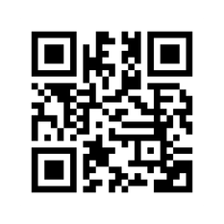
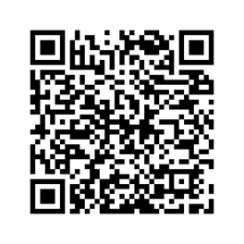
NEW: Swag Request Form!
Use to request conference materials or swag related items.
*You are responsible for 50% of price (Marketing Money can not be used)
https://wkf.ms/4utQZlp
NEW: Marketing Compliance Form!
Use for asking about branding, language, and compliance with marketing materials.
https://forms.monday.com/forms/5a1c2cd9f17220068d04e40425df53ec?r=use1

Slide 9


Friday, April 24th
YELLOW OUT DAY!
Wear Yellow For Children in Hospitals Awareness Month
Send Marketing@chcquotes.com pictures of you “Standing with the Kids”
extendtherose.org/champ

Slide 10

MEDICARE
BOOT CAMP!
June 5 & 6
St. Louis, MO
Invites going out soon!
**For new and experienced agents! Anyone interested in Medicare is welcome to join. We look forward to seeing you soon!

Slide 11


Life Bootcamp!
TAMPA, FL
MAY 15TH AND 16TH
BOOK YOUR HOTEL ROOM TODAY TO GET THE GROUP RATE!!
Monday is the LAST day!
The link is on the back of the evite. If you did not recieve an invite reach out to events@chcquotes.com

Slide 12
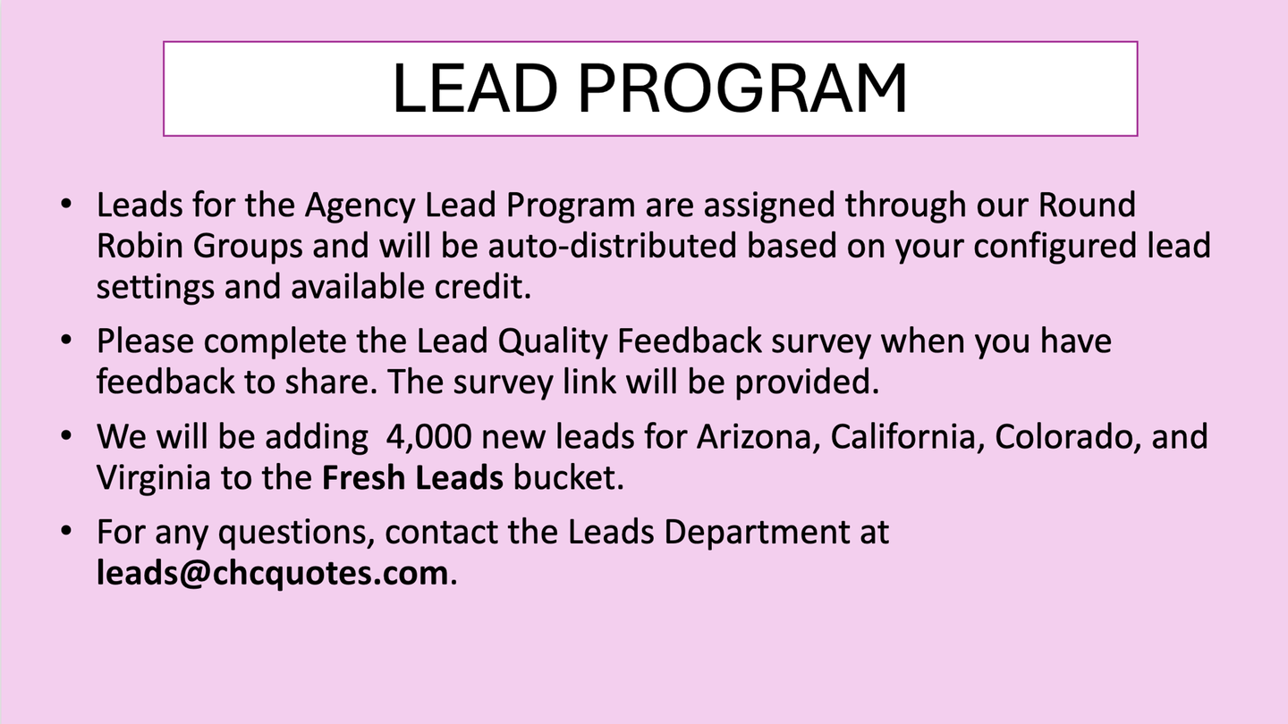
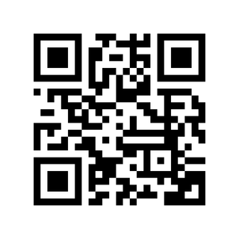

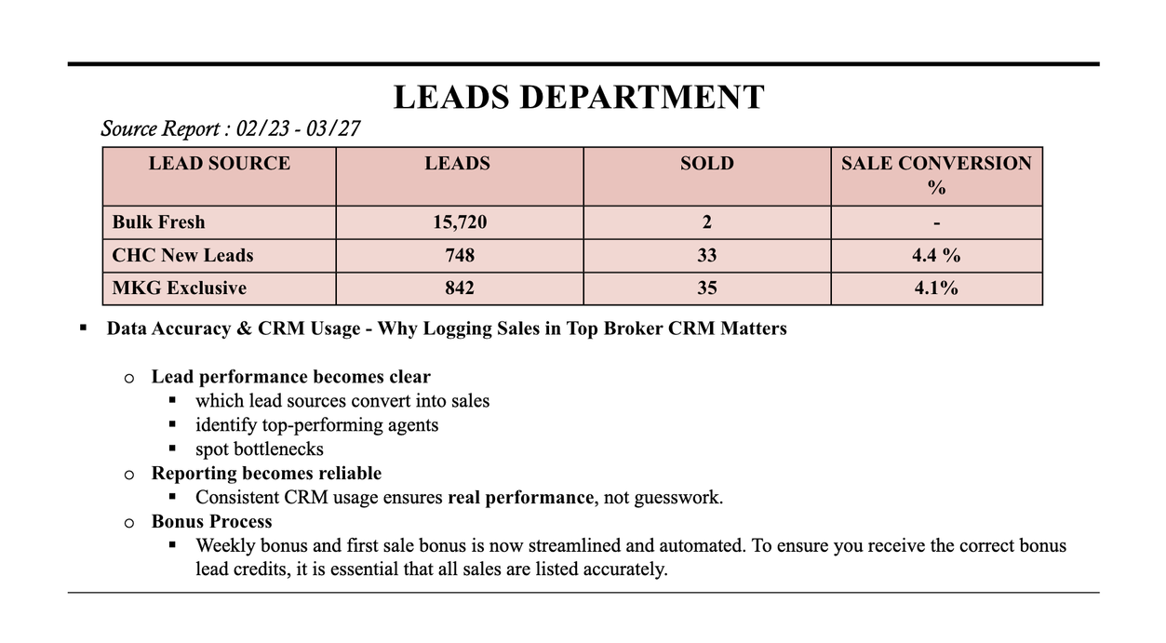
https://wkf.ms/4swRxVy
(Sri)

Slide 13

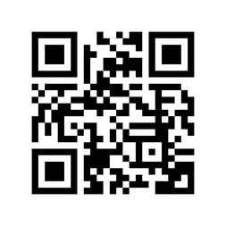
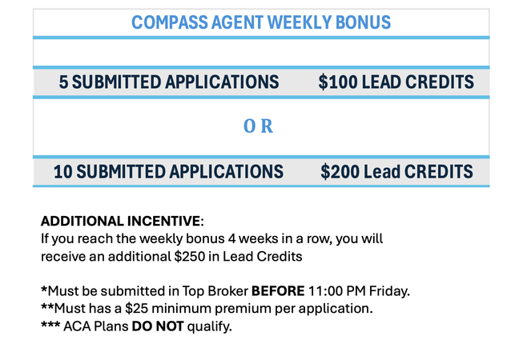
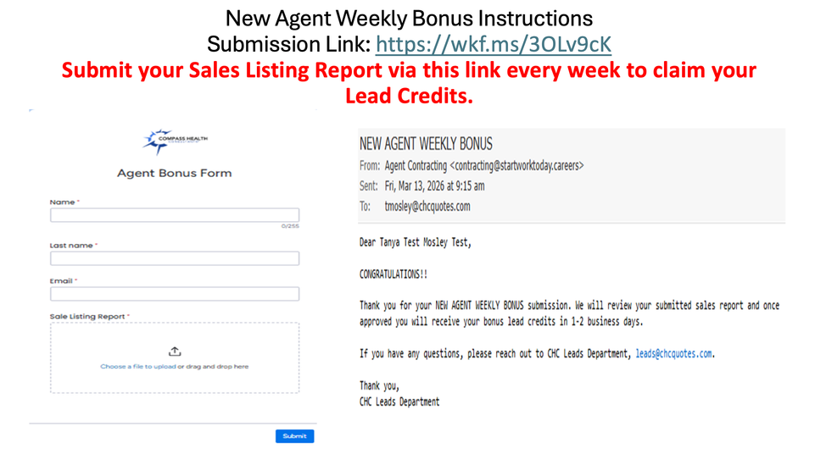
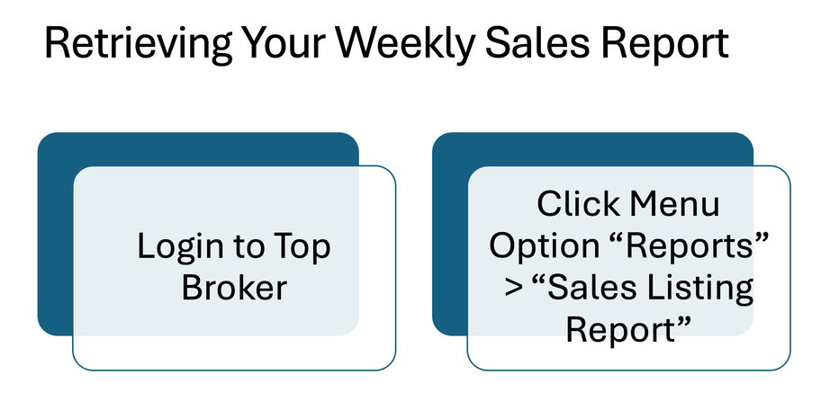
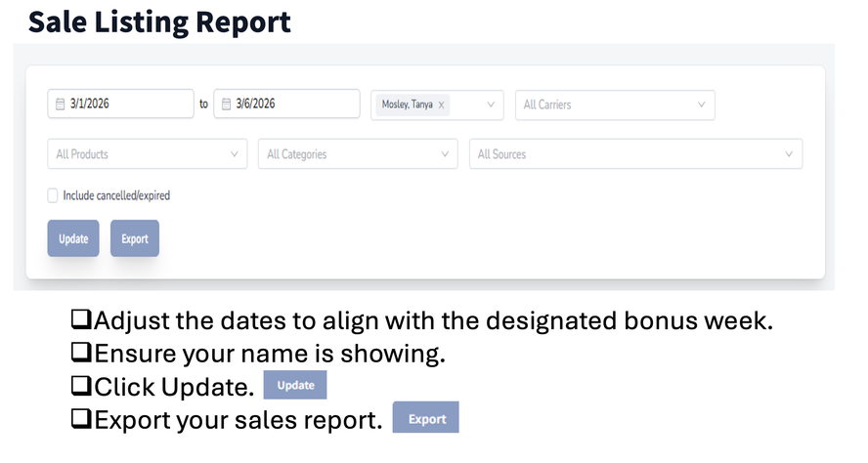
Lead Program: Important Links
Lead Quality Feedback Survey Questionnaire
New Agent Weekly Bonus & First Sale Bonus
CHC NEW AGENT/ WEEKLY LEAD CREDIT BONUS
*We reserve the right to revise, update, or otherwise change the program at our discretion

Slide 14
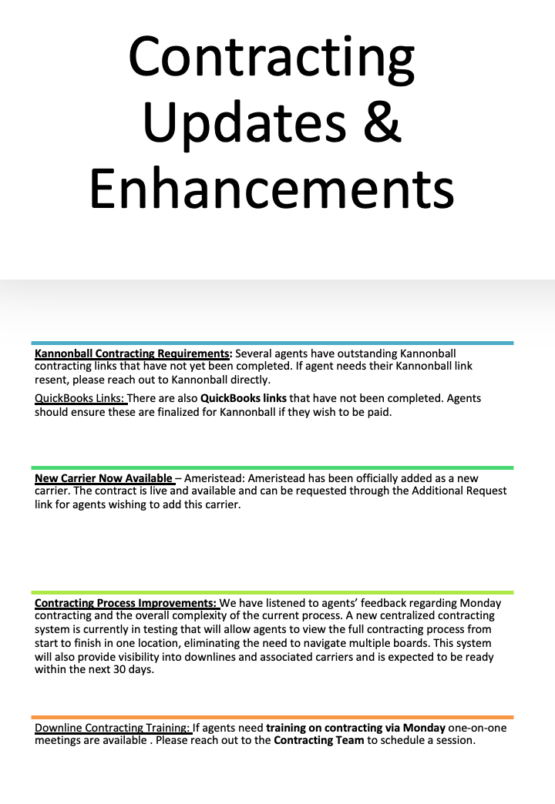

Slide 15

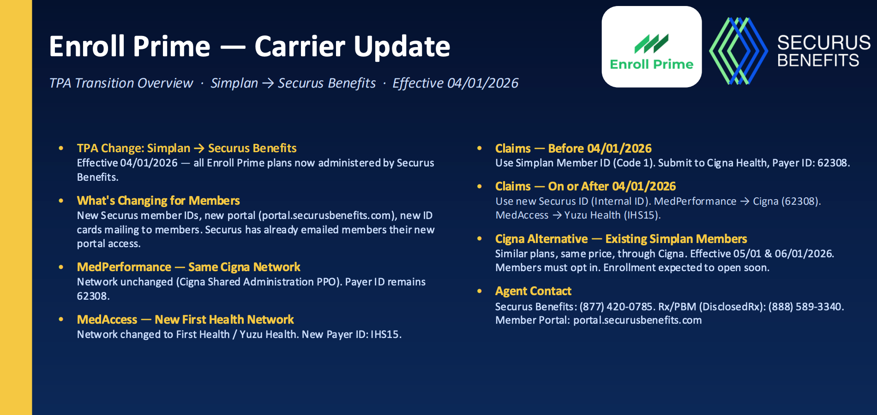

Slide 16
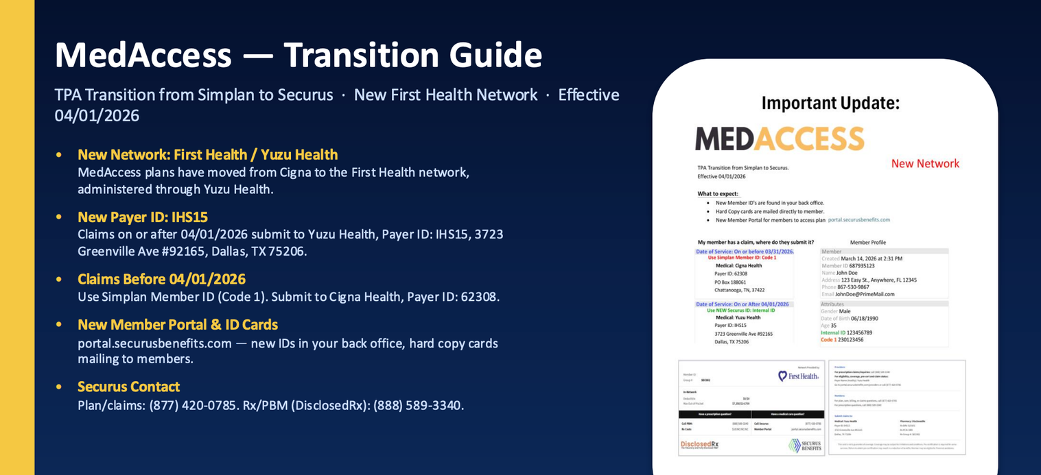
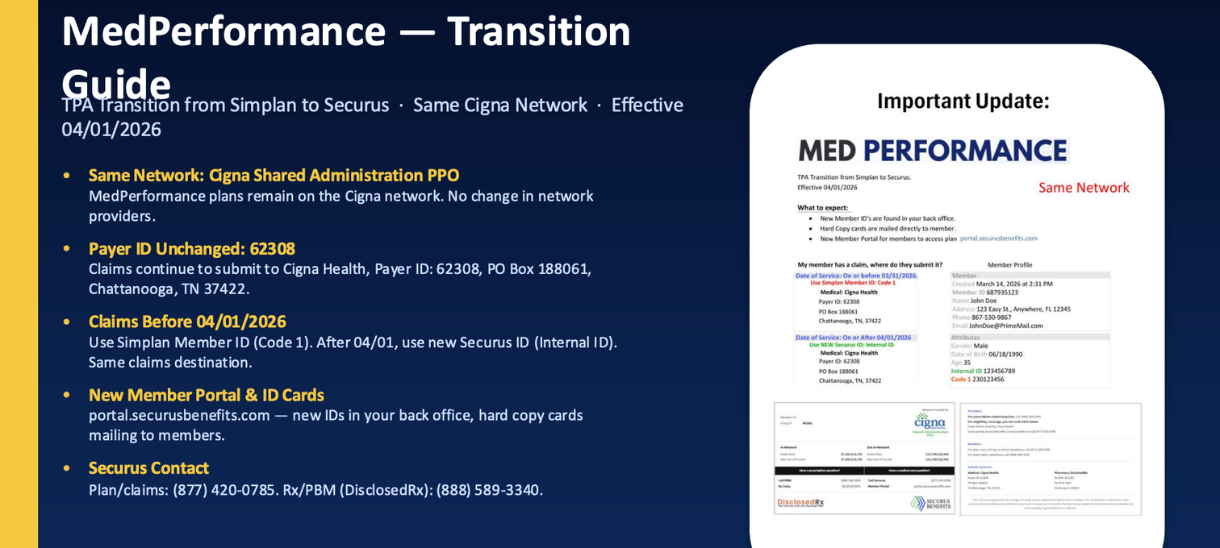

Slide 17

**Make sure to attend next friday’s 11am CST webinar
April 24th

Slide 18
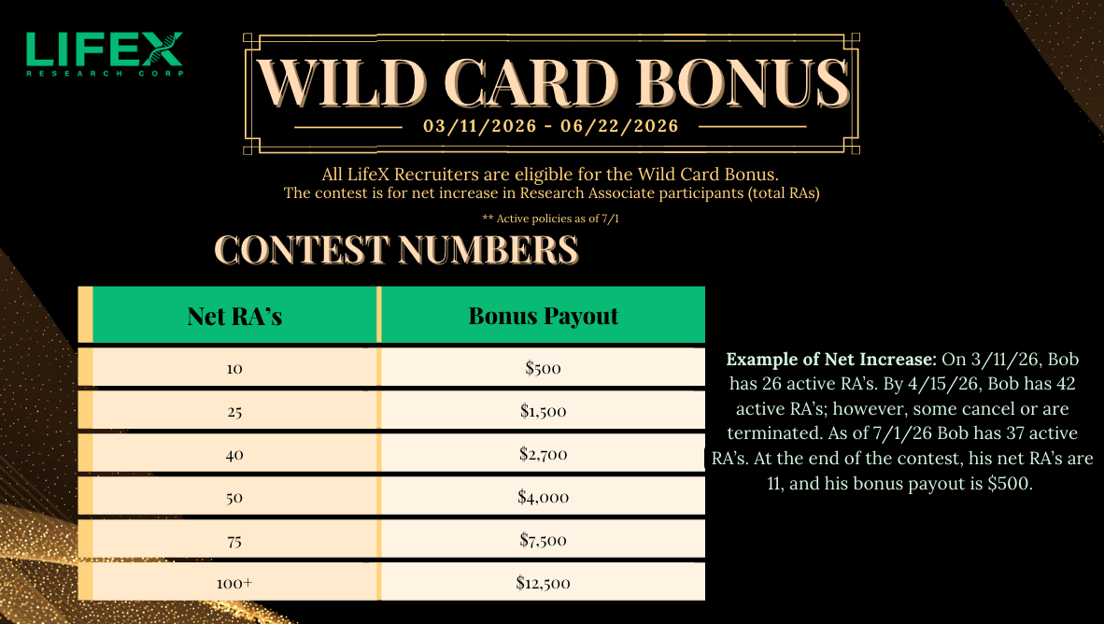

Slide 19





MEGA MULTIPLIER
2ND MEGA MULTIPLIER
1 XGB GROUP WITH 10+ ENROLLED = BONUS X1.25
3 XGB GROUPS OF 10+ ENROLLED = BONUS X1.5
EXAMPLE: $1,500 BONUS = $1,875 WITH MEGA MULTIPLIER
EXAMPLE: $1,500 BONUS = $2,250 WITH 2ND MEGA MULTIPLIER
Super Jackpot Bonus
5+ XGB GROUPS WITH A TOTAL 100+ EMPLOYEES = BONUS X2
EXAMPLE: 100+ LIFEX POLICIES + 5 XGB GROUPS = $25,000 BONUS

Slide 20


Slide 21

PSM New Enrollments Notice of NEW Milliman Suitability Tool
https://discover.ironhealthbenefits.com/suitability/

Slide 22






Slide 23

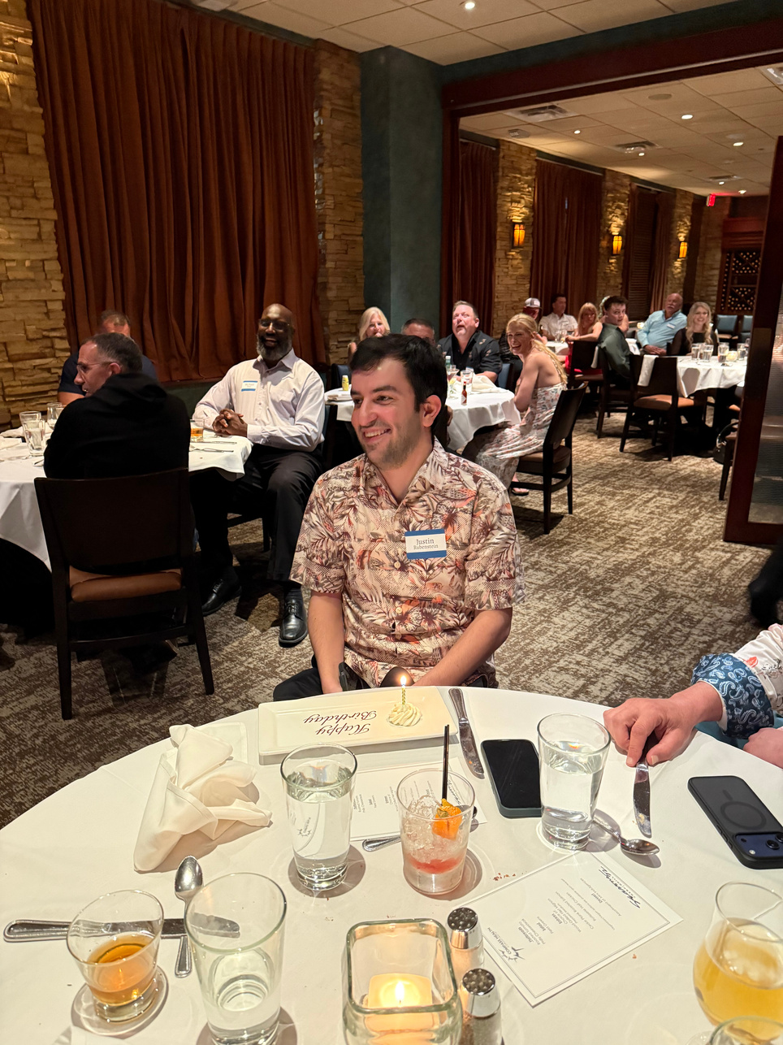
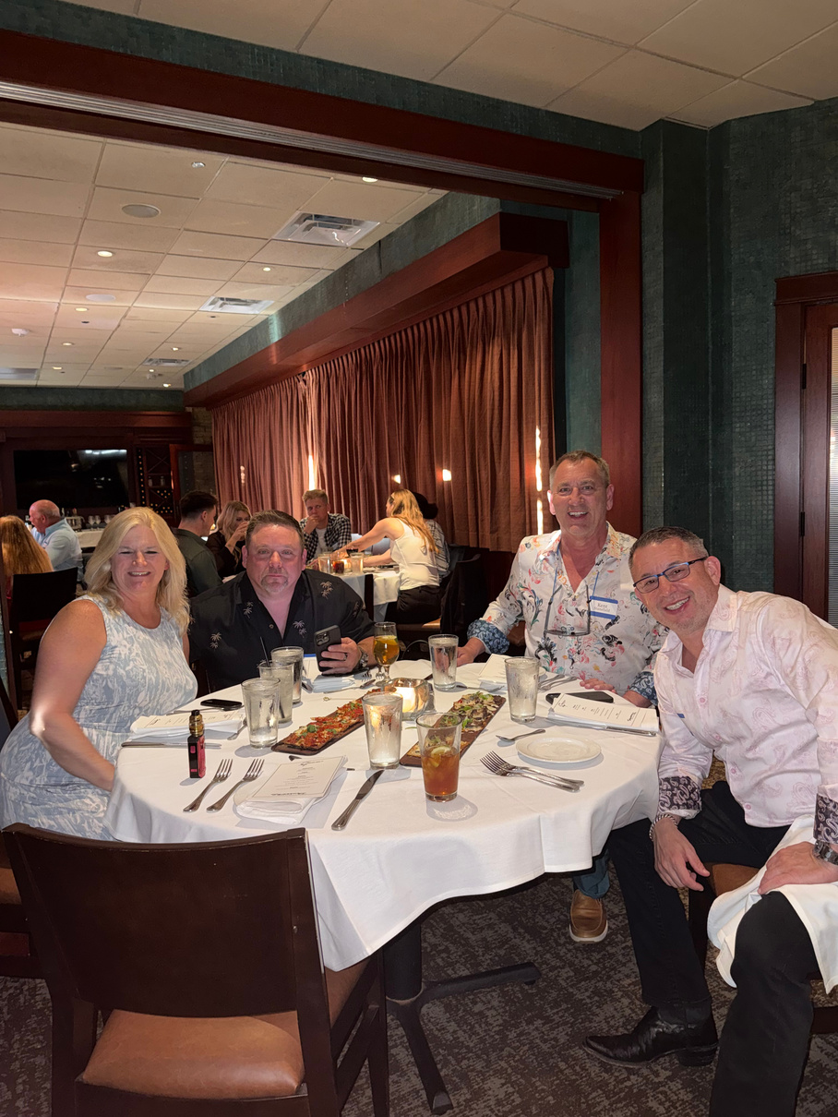
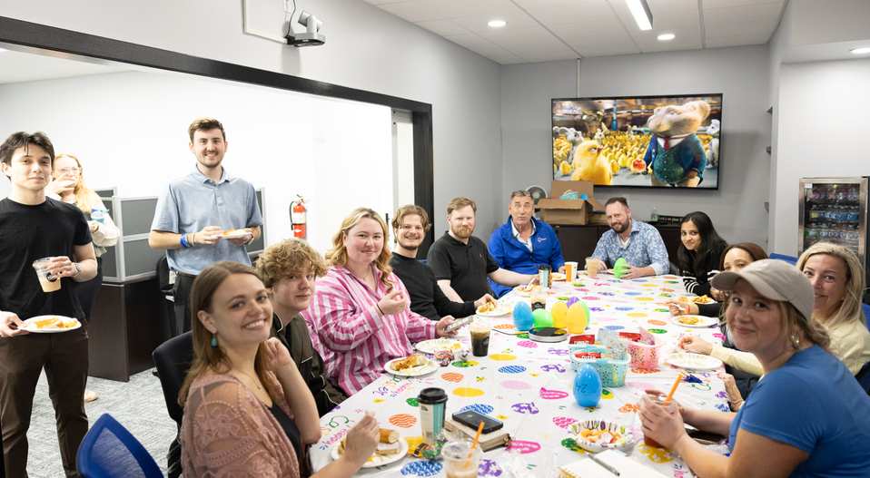
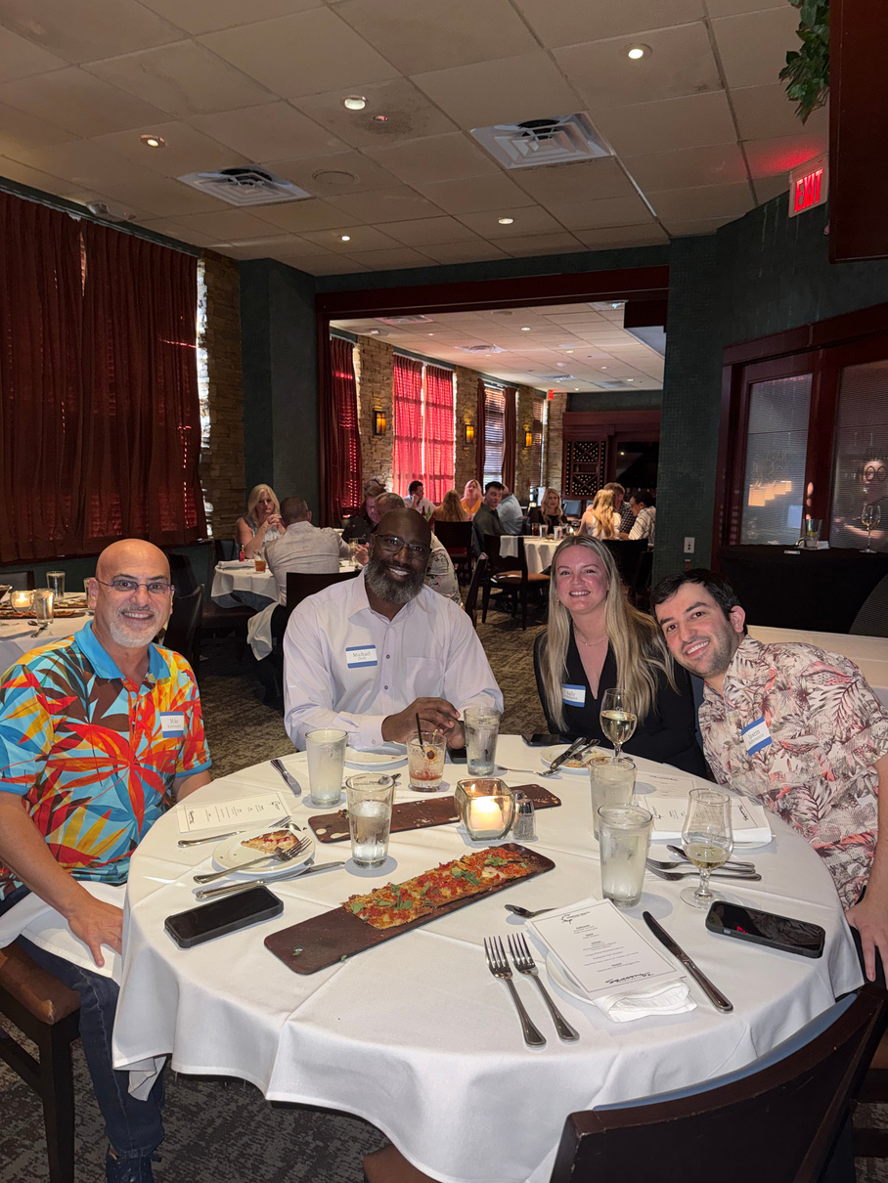

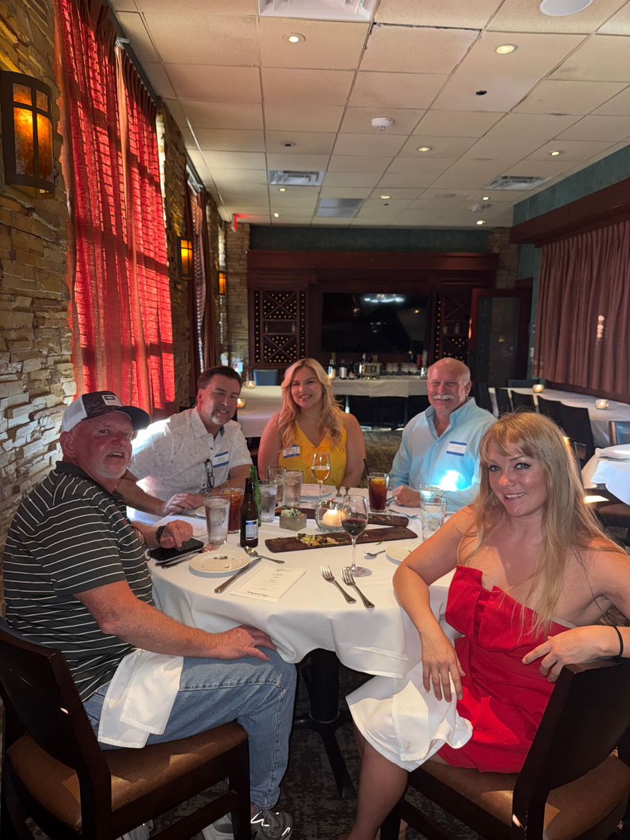
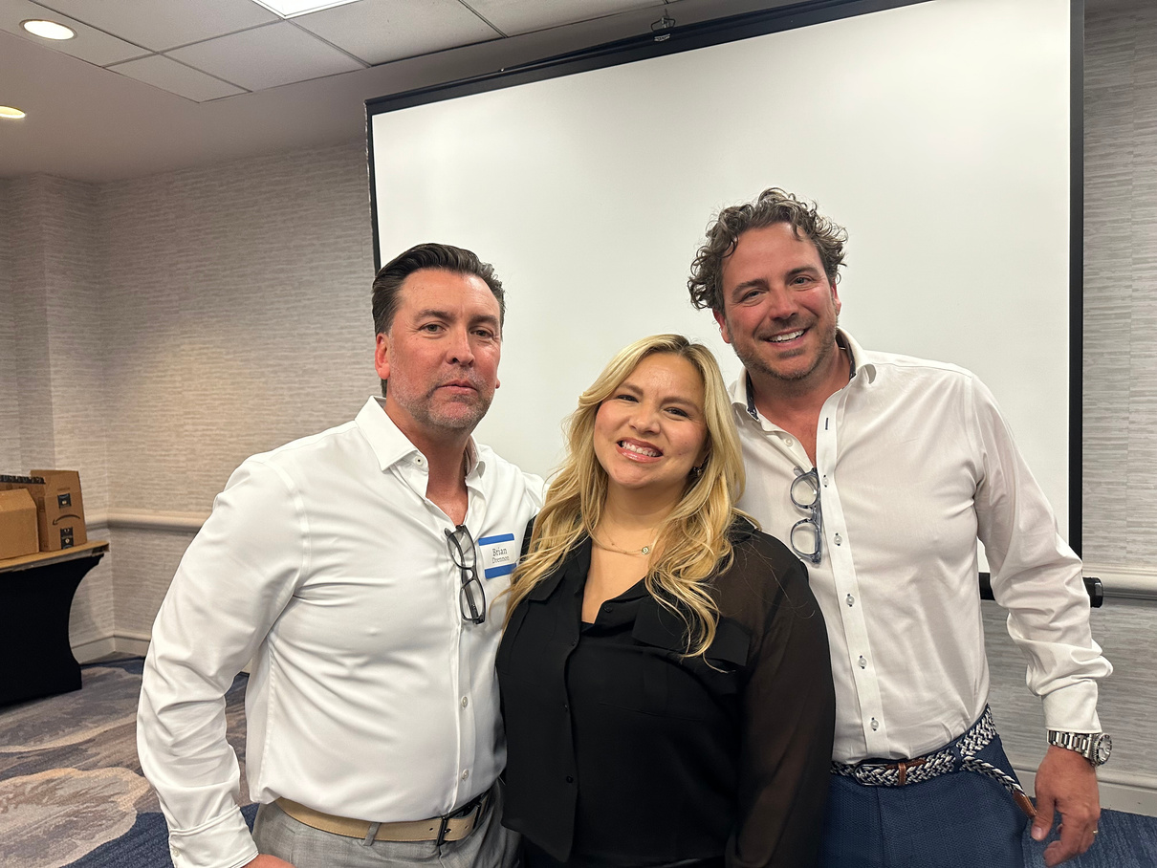
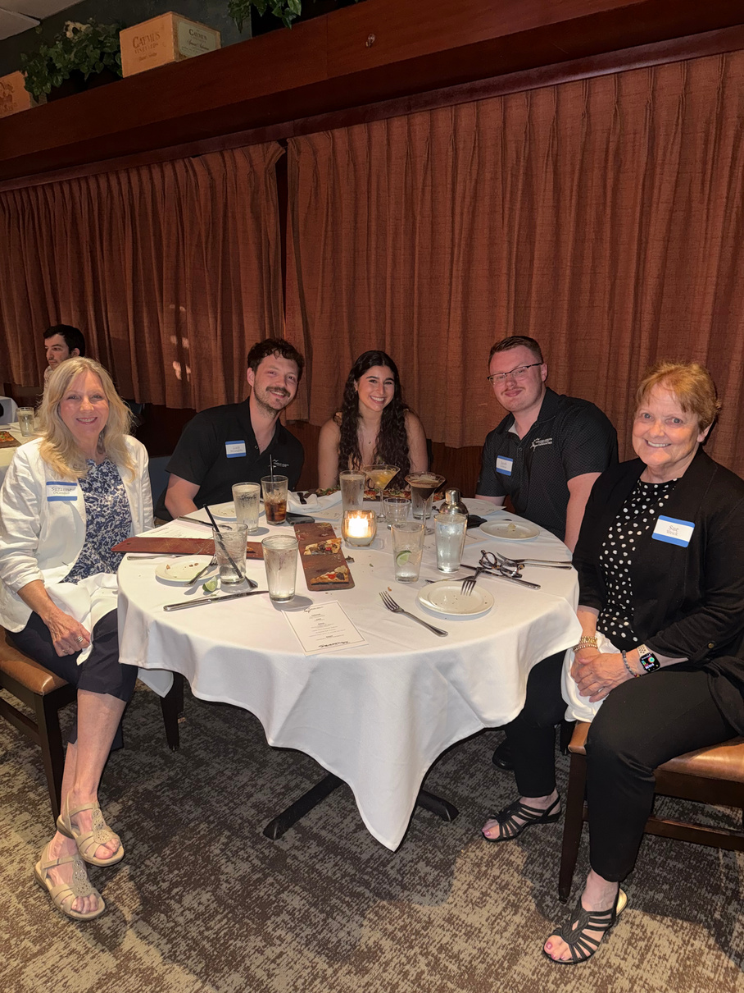
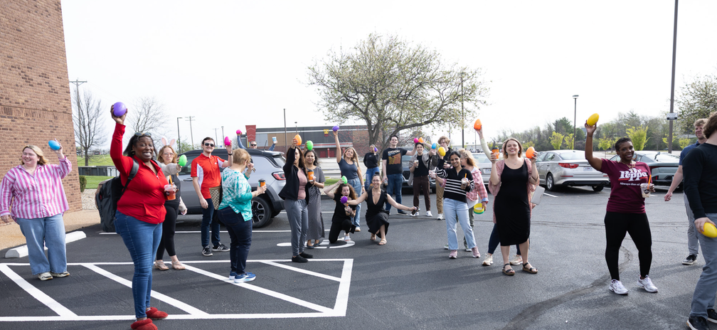
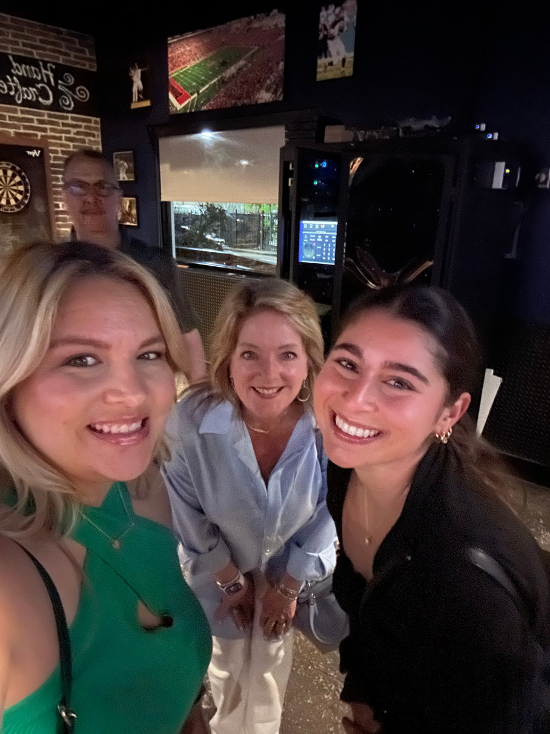
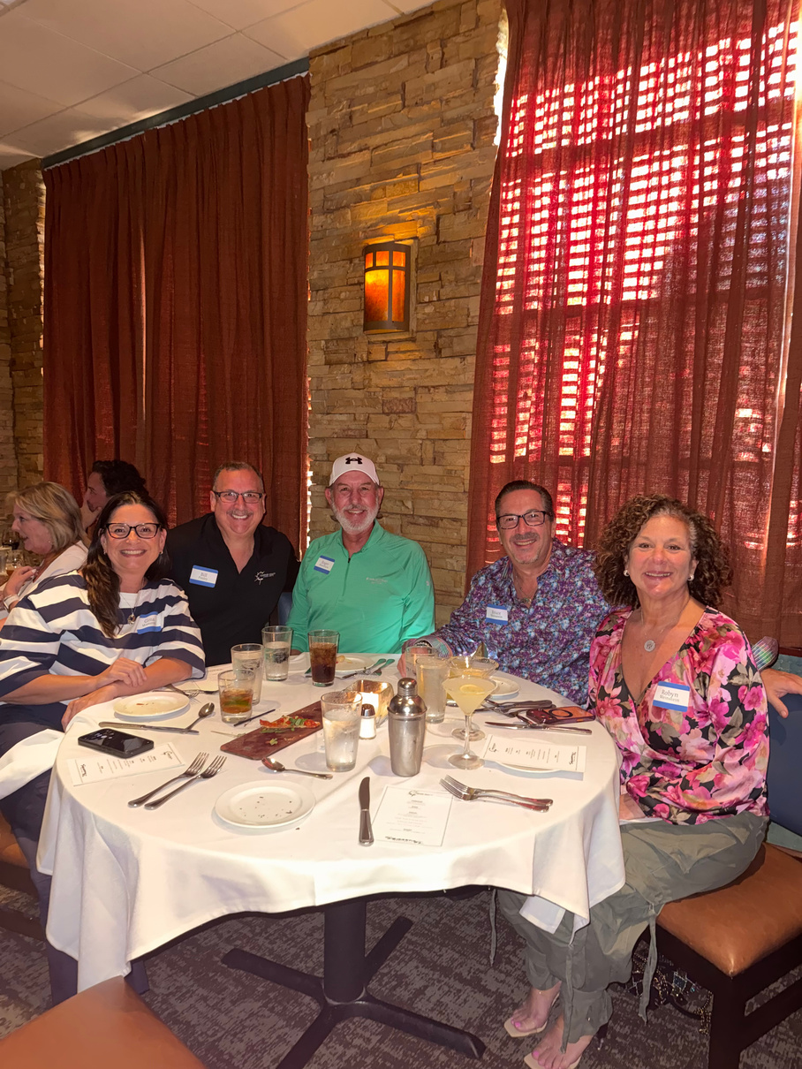
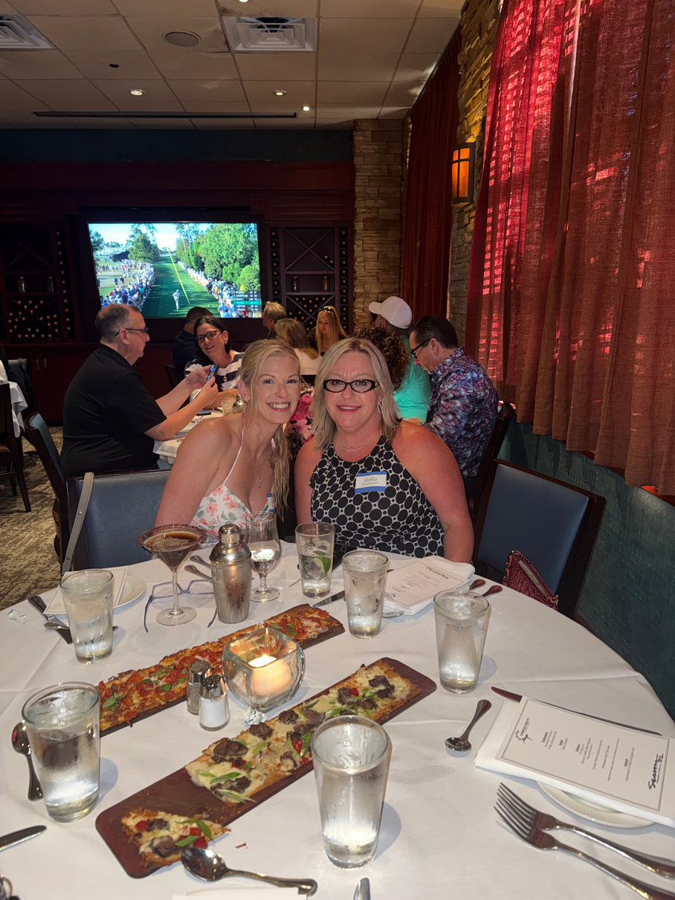
EASTER CELEBRATIONS
& CONFERENCE DAYS!

Slide 24
QUESTIONS?
COMMENTS?
Next Agency Update:
APRIL 30TH
1PM CST

