Slide 1


JK AGENCY UPDATES
THURSDAY, JULY 10
1PM CST
ZOOM MEETING LINK
HTTPS://ZOOM.US/J/3738421209

Slide 2







ATTENTION NEW AGENTS
Sell your first application by next Friday, July 18rd & receive a Compass shirt* and $100 lead credits!
*May be substituted for a $50 CHC store credit
Connect with us!
If you’re not receiving CHC communications (email and texts), please email Mari Krivelow at mkrivelow@chcquotes.com
Follow us!

Slide 3




Do you know someone looking for a new career?
Our next CHC New Agent Training & Development is July 22nd and 23rd in St. Louis. Send your referrals to recruiting@chcquotes.com, and you could get a $1,000 cash bonus when the new recruit hits their 10th paid application. The new agent must hit the 10th paid application in their first
three months.
*Must have a $25 minimum premium per application
*ACA plans do not qualify

Slide 4

UPCOMING
TRAININGS
Kickstart
July 10, 24: Attitude is Everything
July 11, 25: Foundations
July 15, 29: Expectations & Action Plans
July 16, 30: Show Me the Money
July 17, 31: Handling Objections
July 14, 28: Elevator Speech & First 5 Seconds
July 18: How to Build Your Business
Team Dials with Q&A
July 15, 29
New Agent Training
July 22 & 23: St. Louis
Thursday Trainings
Dialing for Dollars
July 10, 24: JK Agency Updates Call
July 17: Group Insurance
July 31: Life Insurance
July 19
Medicare
Medicare Minute Wednesday Every Wed Morning
Monday Madness
Agent Support Training
July 14: Keeping Clients Happy
July 21: Medicare Updates
July 28: LifeX
Every Tuesday at 9am
NEW! LifeX & BHPI Group Webinars
LifeX: Wed / Fri at 11am CST Link on chcagents.com
Keep checking chcagents.com for updates!
**MORE INFORMATION ON CHCAGENTS.COM

Slide 5

Agent Support
We ask that all agents communicate with professionalism and respect so we can work effectively together.

Slide 6


NEW TEXTING NUMBER - OPT IN TODAY
Text “START” to (314) 742-7842
*You'll get a message saying you subscribed to HST STL LLC - that is Compass Health Consultants legal name, and you'll get texting updates through that new number starting soon.

Slide 7


Slide 8


  The deadline for BHPI enrollments is the 15th of the month before the effective date.
  Agents should be sending BHPI enrollment documents to group@themvpplans.com.
  Agents’ questions regarding commission should be directed to their upline manager or LOA. For CHC agents commission schedule is located on the CHC agent website under commissions.
    For all questions about the BHPI plans/enrollment, please go to the website https://www.bhpigroup.com. After reviewing the videos, if you still have questions, please reach out to schedule a call.
  Anthem network is being added
  BHPI Reoccuring Webinar: Wednesdays 4pm CST Link on www.chcagents.com
  1 network under 100 eligible
    2 networks 101-200 eligible
  VL group plans have waiting periods like individual plans

Slide 9




New CHC agents that have not written business yet are eligible to get a 3 months advance for a 6 month period for LifeX and Iron Health!

Slide 10


Notes:
courtney for major issues in bullet point form - court to speak on during call

Slide 11



Network Discussion
Bonus
Notes:
courtney for major issues in bullet point form - court to speak on during call

Slide 12
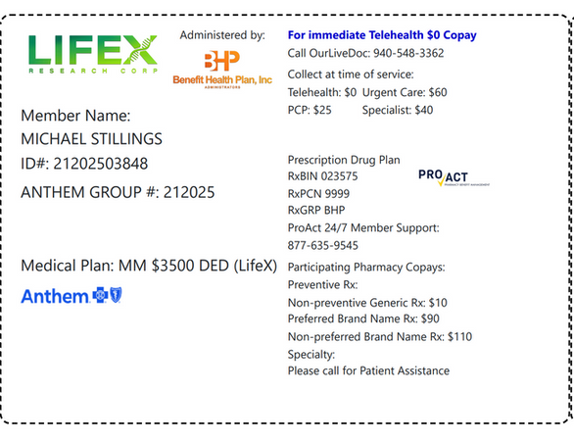
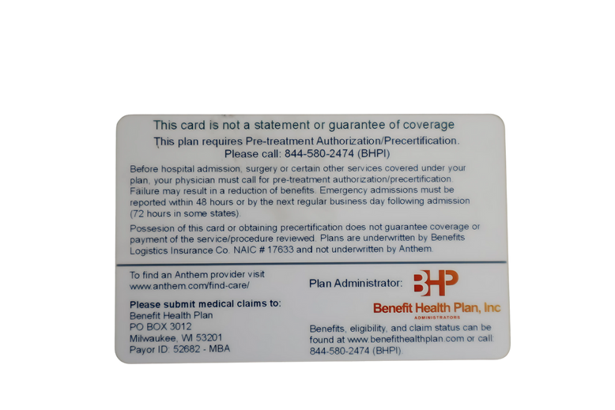



ID CARD

Slide 13
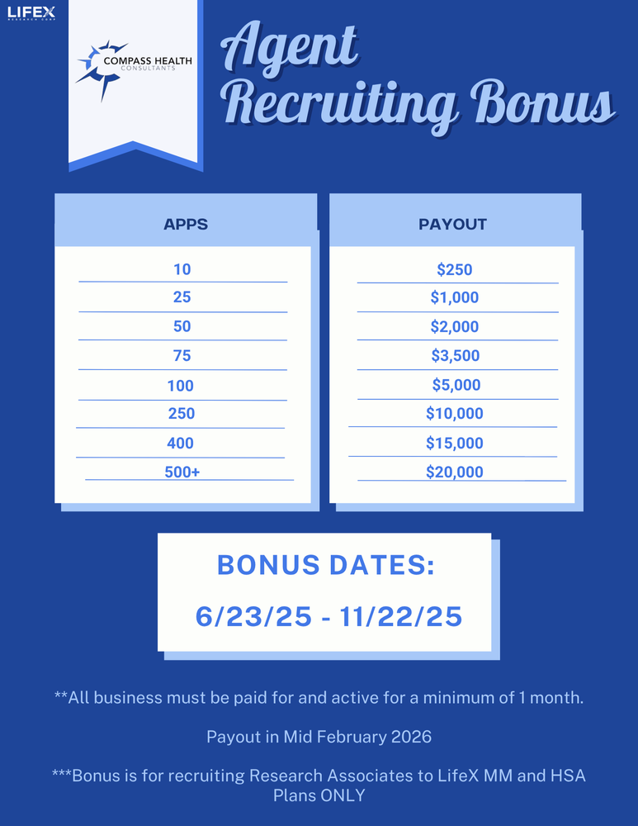

Slide 14




Top 10 Agents July 2025/Submitted
*Only Includes Agency Appointed Carriers
RANK
NAME
# OF APPS
1
2
3
4
5
6
7
8
9
10
Brandon Halbert
Trevor Magloire
Dominic Bove
Jeremy Bright
Tim McCormick
Brian Calvert
Janet Rhonehouse
Jennifer Earp
Robert Weinstein
Richard Hyde
14
11
11
10
10
9
9
9
9
8

Slide 15




SALE!
Notes:
double check w tanya.
65 new people paid this month. math aint mathin

Slide 16
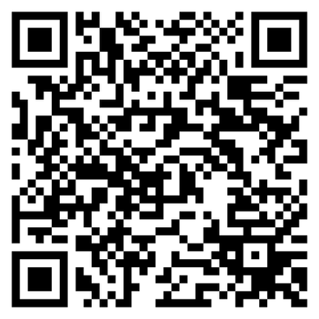

CHC Women’s Council
We’re forming a Women’s Council to create space for connection, learning, and leadership. If you’re interested in being part of it, please complete this short form.

Slide 17


Mastermind: September 20, 2025 (BY INVITE ONLY)
Advanced Agent Training (ELEV8 with SWAT): September 18-19, 2025
ATTENTION NEW AGENTS - COME AND LEARN FROM INDUSTRY LEADERS
**both events are by invitation only. More information to follow

Slide 18


CARRIER BLITZ
September 25 - 28
Nashville, TN

Slide 19



CHC Award Trip!
March 19 - 22, 2026
4 nights
Notes:
ameribenefit plan
iron health
flex benefit
med mutual
enroll prime
lifex
ncd
oneshare
group
iron health and enroll prime and one share: $10 Compass Cash
lifex: $15 compass cash
everything else except for group: $5 compass cash
group: $5 CC per employee
rules: each application submitted and paid june 1 until 12/22 you will get that amount of compass cash towards the cost of your trip. all policies written from jan 1 - may 31st they will be given 50% credit ($10 with be $5). the top 15 agents and top 3 leaders by compass cash points will go for free. leaders credit equals 1/3 the credit of the agents credit.
CC is redeemable towards the cost of the trip including up to $750 of flight credit
top 15 free hotel accomodation + 750 flight credit per couple
ask amy: drop dead date (when to let us know if they're going on trip) (dad thinks Jan 15)
ON ACTUAL BUSINESS - NOT TB

Slide 20
CHC Award Trip!
Rules
  Each application submitted and paid June 1 - Dec 22 2025 you’ll get the amount listed below of Compass Cash towards cost of the trip
  All policies written from Jan 1 - May 31 2025 (Previously written) will be given 50% credit
  Top 15 agents and top 3 leaders (by Compass Cash points) will attend the trip for free** (Free hotel accommodation + $750 towards flights per couple**)
  Leaders credit is ⅓ of their agents credit
Carrier | Compass Cash Per Policy Sold
LifeX | $15
Enroll Prime Iron Health OneShare | $10
AmeriBenefit Flex Benefits MedMutual NCD | $5
Group Health Policies | $5 per employee
For those that are NEW agents who’ve submitted their first app after June 1st 2025, all points are DOUBLED!
***Based on ACTUAL BUSINESS, not TopBroker
Notes:
ameribenefit plan
iron health
flex benefit
med mutual
enroll prime
lifex
ncd
oneshare
group
iron health and enroll prime and one share: $10 Compass Cash
lifex: $15 compass cash
everything else except for group: $5 compass cash
group: $5 CC per employee
rules: each application submitted and paid june 1 until 12/22 you will get that amount of compass cash towards the cost of your trip. all policies written from jan 1 - may 31st they will be given 50% credit ($10 with be $5). the top 15 agents and top 3 leaders by compass cash points will go for free. leaders credit equals 1/3 the credit of the agents credit.
CC is redeemable towards the cost of the trip including up to $750 of flight credit
top 15 free hotel accomodation + 750 flight credit per couple
ask amy: drop dead date (when to let us know if they're going on trip) (dad thinks Jan 15)
ON ACTUAL BUSINESS - NOT TB

Slide 21





Questions? Comments?
Next JK Update: Thursday July 10th
Follow us on social media!

