Slide 1


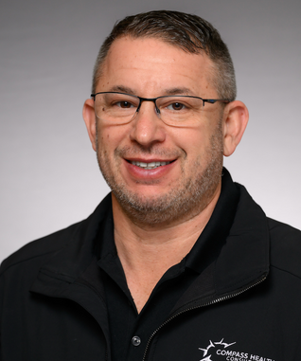
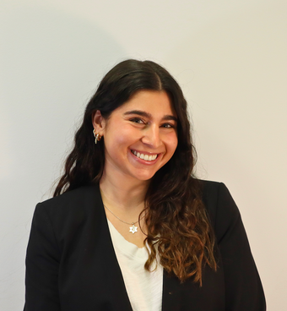
JK AGENCY UPDATES
THURSDAY, JUNE 26
1PM CST
ZOOM MEETING LINK
HTTPS://ZOOM.US/J/3738421209
Today’s Host: The BEST Krivelow!

Slide 2







ATTENTION NEW AGENTS
Sell your first application by next Friday, July 3rd & receive a Compass shirt* and $100 lead credits!
*May be substituted for a $50 CHC store credit
Connect with us!
If you’re not receiving CHC communications (email and texts), please email Mari Krivelow at mkrivelow@chcquotes.com
Follow us!

Slide 3




Do you know someone looking for a new career?
Our next CHC New Agent Training & Development is July 8th and 9th in Tampa. Send your referrals to recruiting@chcquotes.com, and you could get a $1,000 cash bonus when the new recruit hits their 10th paid application. The new agent must hit the 10th paid application in their first
three months.
*Must have a $25 minimum premium per application
*ACA plans do not qualify

Slide 4

UPCOMING
TRAININGS
Kickstart
June 26, July 10, 24: Attitude is Everything
June 27, July 11, 25: Foundations
July 1, 15, 29: Expectations & Action Plans
July 2, 16, 30: Show Me the Money
July 3, 17, 31: Handling Objections
July 14, 28: Elevator Speech & First 5 Seconds
July 18: How to Build Your Business
Team Dials with Q&A
July 1, 8, 15, 29
New Agent Training
July 8 & 9: Tampa
July 22 & 23: St. Louis
Thursday Trainings
Dialing for Dollars
July 3: Under 65 Products
July 10, 24: JK Agency Updates Call
July 17: Group Insurance
July 31: Life Insurance
July 19
Medicare
Medicare Minute Wednesday Every Wed Morning
Monday Madness
Agent Support Training
June 30: Insurance Basics
July 7: Flex Benefits
July 14: Keeping Clients Happy
July 21: Medicare Updates
July 28: LifeX
Every Tuesday at 9am
NEW! LifeX & BHPI Group Webinars
LifeX: Wed / Fri at 11am CST Link on chcagents.com
Keep checking chcagents.com for updates!
**MORE INFORMATION ON CHCAGENTS.COM

Slide 5


AHIP is BACK
Visit www.chcagents.com/medicare today. Scroll down to Module 1-5 Exam Books!

Slide 6


Monthly Newsletter:
First Monday of Every Month!
To view: Go to www.chcagents.com/marketing and view the Newsletter tab!
To nominate a staff member of agent by emailing: Marketing@chcquotes.com

Slide 7


Join the Chc Agents Channel
https://compasshealth-poc4420.slack.com/archives/C08LQLDU0BH
NEW agents and managers will have another channel as well!**
IF THE LINK DOESN’T WORK, EMAIL MKRIVELOW@CHCQUOTES TO BE ADDED TO THE CHANNEL

Slide 8




Subscription billing cycle:
Billed ANNUALLY in JULY
If you currently have Teemyco, you'll receive an email asking if you would like to keep your subscription next year.
If you want to join, or cancel Teemyco, email:
projectmanager@chcquotes.com

Slide 9


Quotit will be CANCELLED as of July 1, 2025

Slide 10


  The deadline for BHPI enrollments is the 15th of the month before the effective date.
  Agents should be sending BHPI enrollment documents to group@themvpplans.com.
  Agents’ questions regarding commission should be directed to their upline manager or LOA. For CHC agents commission schedule is located on the CHC agent website under commissions.
    For all questions about the BHPI plans/enrollment, please go to the website https://www.bhpigroup.com. After reviewing the videos, if you still have questions, please reach out to schedule a call.
  Anthem network is being added
  BHPI Reoccuring Webinar: Wednesdays 4pm CST Link on www.chcagents.com
  1 network under 100 eligible
    2 networks 101-200 eligible
  VL group plans have waiting periods like individual plans

Slide 11




New CHC agents that have not written business yet are eligible to get a 3 months advance for a 6 month period for LifeX and Iron Health!

Slide 12



Network Discussion
Bonus
Notes:
courtney for major issues in bullet point form - court to speak on during call

Slide 13
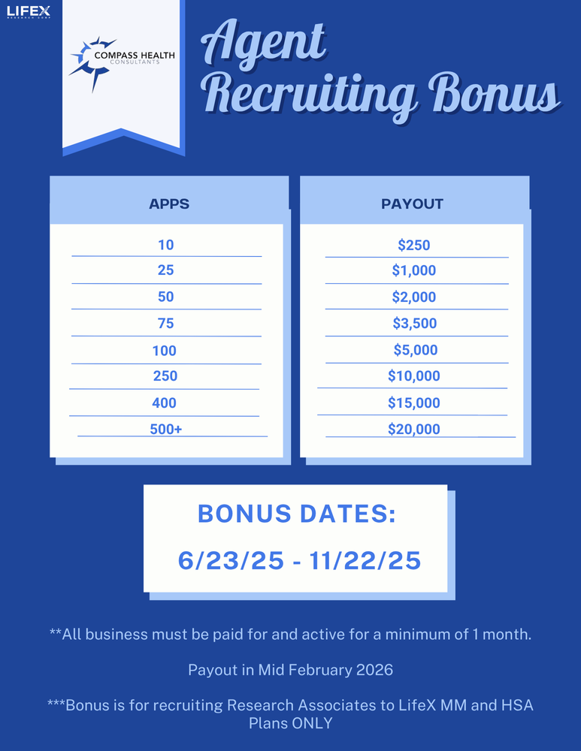

Slide 14

Self Training:
SIMERP: https://www.loom.com/share/8d6008edd3d04bda9d5dd1dcae0d0134?sid=3c8a769a-f1fc-46ad-8302-502f0ffcce30
Understanding Paycheck Impact - Watch Video
In this video, I explain how our wellness program affects employee paychecks, using a typical example of an employee earning $39,520 annually. By enrolling in the program, employees can reduce their taxable income, leading to significant savings on federal, state, Social Security, and Medicare taxes. This results in an increase in their take-home pay, which can be used for wellness benefits. I encourage you to consider how this program can benefit our employees and to share any thoughts you have.
Revive Wellness Program Overview 🌟 - Watch Video
In this video, I walk you through the Revive wellness program, highlighting its features like urgent care access, primary care consultations, and mental health support. I demonstrate how to navigate the platform, select providers, and utilize available medications, all without co-pays or deductibles. It's essential for you to familiarize yourself with these resources, as they can significantly benefit our team. Please take a moment to explore the platform and let me know if you have any questions!

Slide 15


Contest
Agents can earn $100 for every $4,000 in annualized volume on any Med Mutual product submitted between June 16th and June 30th
Lets finish June strong !

Slide 16




Top 10 Agents June 2025/Submitted
*Only Includes Agency Appointed Carriers
RANK
NAME
# OF APPS
1
2
3
4
5
6
7
8
9
10
Jasmine Garcia
Lauren Kochensparger
Travis Walker
Ken Bardales
Tom Trifaro
Bill Pauley
Phil Vogt
Breck McMichael
Cynthia Rodriguez
Joe & Maggie Roeder
56
48
45
44
40
34
34
33
31
30

Slide 17




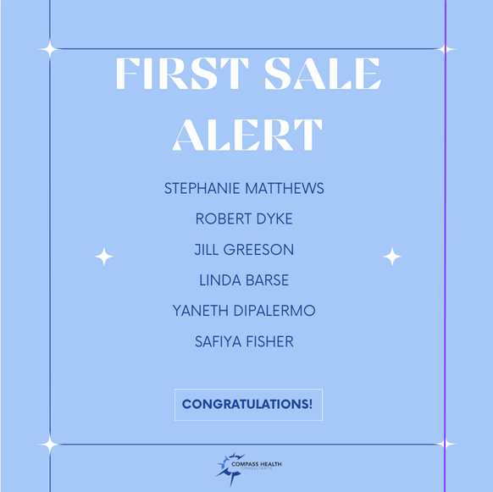
SALE!
Notes:
double check w tanya.
65 new people paid this month. math aint mathin

Slide 18


Mastermind: September 20, 2025 (BY INVITE ONLY)
Advanced Agent Training: September 18-19, 2025
ATTENTION NEW AGENTS - COME AND LEARN FROM INDUSTRY LEADERS
**both events are by invitation only. More information to follow

Slide 19



CHC Award Trip!
March 19 - 22, 2026
4 nights
Notes:
ameribenefit plan
iron health
flex benefit
med mutual
enroll prime
lifex
ncd
oneshare
group
iron health and enroll prime and one share: $10 Compass Cash
lifex: $15 compass cash
everything else except for group: $5 compass cash
group: $5 CC per employee
rules: each application submitted and paid june 1 until 12/22 you will get that amount of compass cash towards the cost of your trip. all policies written from jan 1 - may 31st they will be given 50% credit ($10 with be $5). the top 15 agents and top 3 leaders by compass cash points will go for free. leaders credit equals 1/3 the credit of the agents credit.
CC is redeemable towards the cost of the trip including up to $750 of flight credit
top 15 free hotel accomodation + 750 flight credit per couple
ask amy: drop dead date (when to let us know if they're going on trip) (dad thinks Jan 15)
ON ACTUAL BUSINESS - NOT TB

Slide 20
CHC Award Trip!
Rules
  Each application submitted and paid June 1 - Dec 22 2025 you’ll get the amount listed below of Compass Cash towards cost of the trip
  All policies written from Jan 1 - May 31 2025 (Previously written) will be given 50% credit
  Top 15 agents and top 3 leaders (by Compass Cash points) will attend the trip for free** (Free hotel accommodation + $750 towards flights per couple**)
  Leaders credit is ⅓ of their agents credit
Carrier | Compass Cash Per Policy Sold
LifeX | $15
Enroll Prime Iron Health OneShare | $10
AmeriBenefit Flex Benefits MedMutual NCD | $5
Group Health Policies | $5 per employee
For those that are NEW agents who’ve submitted their first app after June 1st 2025, all points are DOUBLED!
***Based on ACTUAL BUSINESS, not TopBroker
Notes:
ameribenefit plan
iron health
flex benefit
med mutual
enroll prime
lifex
ncd
oneshare
group
iron health and enroll prime and one share: $10 Compass Cash
lifex: $15 compass cash
everything else except for group: $5 compass cash
group: $5 CC per employee
rules: each application submitted and paid june 1 until 12/22 you will get that amount of compass cash towards the cost of your trip. all policies written from jan 1 - may 31st they will be given 50% credit ($10 with be $5). the top 15 agents and top 3 leaders by compass cash points will go for free. leaders credit equals 1/3 the credit of the agents credit.
CC is redeemable towards the cost of the trip including up to $750 of flight credit
top 15 free hotel accomodation + 750 flight credit per couple
ask amy: drop dead date (when to let us know if they're going on trip) (dad thinks Jan 15)
ON ACTUAL BUSINESS - NOT TB

Slide 21

Our St. Charles office will be CLOSED this Friday, June 27th at 12pm CST
We are very sorry for the inconvenience. We will be back to normal business hours Monday, June 30th

Slide 22

Join us on TOMORROW
June 27th
10am CST

Slide 23





Questions? Comments?
Next JK Update: Thursday July 10th
Follow us on social media!

