Slide 1
JK Agency Updates
Thursday, March 13th
1PM CST
Zoom Meeting Link
https://zoom.us/j/3738421209

Slide 2
For all those that joined us at our trainings this past week!

Slide 3
Special thank you to our amazing managers! Without you - we wouldn’t be able to do what we do

Slide 4
ATTENTION NEW AGENTS
Sell your first application by next Friday, March 21th & receive a Compass shirt* and $100 lead credits!
*May be substituted for a $50 CHC store credit
Email mkrivelow@chcquotes.com to receive
Connect with us!
If you’re not receiving CHC communications (email and texts), please email Mari Krivelow at mkrivelow@chcquotes.com
Follow us!

Slide 5
Do you know someone looking for a new career?
Our next CHC New Agent Training & Development is March 25 & 26th in Tampa & STL. Send your referrals to Liz Wardrop, ewardrop@chcquotes.com, and you could get a $1,000 cash bonus when the new recruit hits their 10th paid application. The new agent must hit the 10th paid application in their first
three months.
*Must have a $25 minimum premium per application
*ACA plans do not qualify

Slide 6
UPCOMING
TRAININGS
Kickstart
Team Dials with Q&A
March 14 & 28 - Attitude is Everything
March 17: Elevator Speech & First 5 Seconds
March 18: Expectations & Action Plans
March 19 Show Me the Money
March 20: Handling Objections
March 21: How to Build Your Business
March 27: Foundations
March 18, 25
New Agent Training
March 25 & 26: LIVE in Tampa & STL
Dialing for Dollars
March 22
Thursday Trainings
Medicare
March 20: Group Insurance
March 27: JK Agency Updates Call
Medicare Minute Wednesday Every Wed Morning
NEW! Agent Support Training
Monday Madness
March 17: EHP
March 24: Enroll Prime
Every Tuesday at 9am
NEW! LifeX Webinars
March 14, 18, 20
**MORE INFORMATION ON CHCAGENTS.COM

Slide 7
Affiliate Site NEW UPDATE
Contact mkrivelow@chcquotes.com to get your own webpage!
You can now integrate your website with TopBroker!!!
GET FREE (LIMITED TIME): $40 lead credit until May 5

Slide 8
NEW BUSINESS CARD DESIGNS
https://chc.hotprints.com/
Visit chcagents.com --> Resources --> Important Links to get your very own!

Slide 9
For more info, please contact Holly Adkison at Hadkison@chcquotes.com or call 636-280-9229

Slide 10
Advanced Agent Training &
Mastermind Recap

Slide 11
Gigcare Discussion
AC Updates
Notes:
courtney for major issues in bullet point form - court to speak on during call

Slide 12
AGENT SUPPORT
Please wait a MINIMUM of 24-48 hours before sending the same inquiry to agent support.
Please do NOT to cc: clients on agent support
Customer support email is for Open Enrollment
We’ve added an Agent Support Updates Call every Tuesday morning at 9am CST on a NEW LINK. Please reference chcagents.com. INVITE YOUR DOWNLINES!
If you’re not there by 9:05, you will not be let in to the training. You can find the recordings on chcagents.com in the video library!

Slide 13
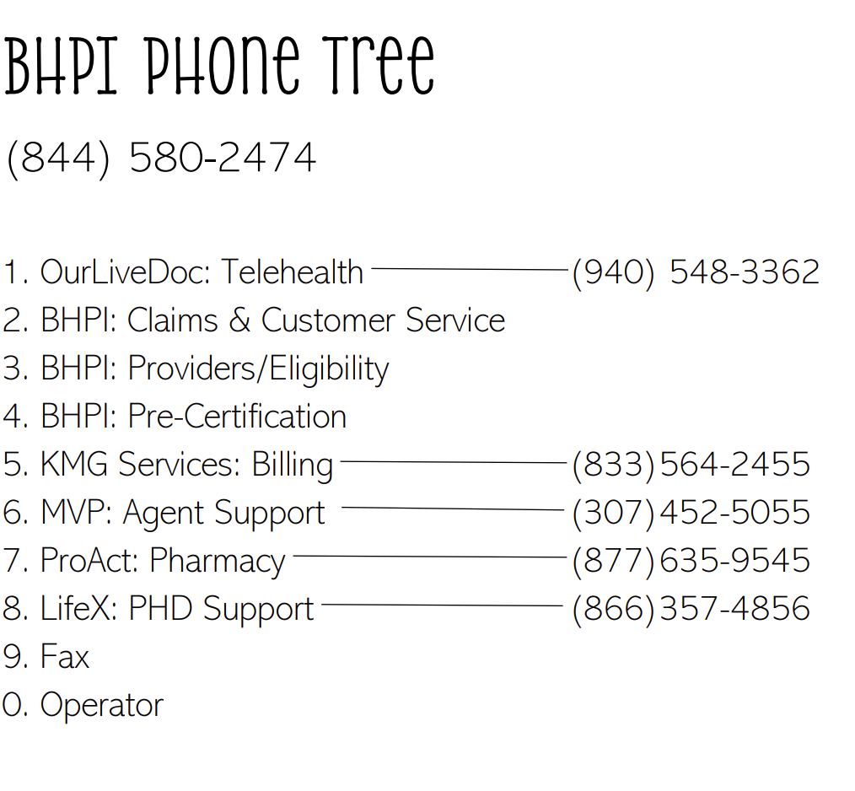

Slide 14
LIFEX WEBINARS WILL BE ON CHCAGENTS.COM CALENDAR
FIND MORE INFORMATION AND ALL PLAN DOCUMENTS ON
LIFEXPLANS.COM
**Sign in and have access to all documents
Notes:
courtney for major issues in bullet point form - court to speak on during call

Slide 15
CHC Finance Department
PAYCOR
We’ve started using a new software program for our direct deposits. They will come from “HST STL LLC”
Be on the lookout for an email from Paycor to set up your agent facing portal within the next week. This is NOT a replacement of EAgent Center - Paycor gives visibility into deposits, NOT commissions.
Agents and managers may receive automated emails that come from “chccontracting@startworktoday.careers” requesting missing information for onboarding paperwork such as SSN, DOB, Voided Check, or W9. These emails are from Compass, please do NOT mark as spam, and please be sure to take action on the request you receive, to avoid delays in commissions for yourself or one of your downline agents.

Slide 16
CHC Contracting Department
Hiring Managers: https://wkf.ms/4cErFQa Request invitation to contract your recruit with CHC
CHC Contracted Agents: CHC Additional Carrier Requests
Link: https://forms.monday.com/forms/9508297440e8ac95cfedbacaeebe7896?r-use1
CHC Contracting Staff: Tanya Mosley & Mimi Crisostomo
Emails: contracting@chcquotes.com contracting@startworktoday.careers
Notes:
add med mutual winners
take med mutual off they need to other links

Slide 17
CHC Contracting Department
Request LifeX from the Additional Carrier Link, you will need your upline’s LifeX Agent ID
Please allow a full 2 business days to recieve your testing certification email from KMG. Please do not submit more than once
If it has been more than 2 full business days, email CHC contracting at contracting@chcquotes.com
LifeX Welcome Emails will come from support@kmg-services.com, with a Subject Line: Dedicated Enrollment Platform
Notes:
add med mutual winners
take med mutual off they need to other links

Slide 18
Agent Samia Williams:
St. Louis Networking Event
“Small business owners, sole proprietors, and entrepreneurs: we all know it’s hard to reach out and find other small business owners to connect with - I’m here to help!”
Date: TOMORROW Friday, March 14th
Time: Drink Specials 8-11pm
Participating Venues: Sports & Social
651 Clark Ave, St. Louis, MO 63102
Check-In Location: 8-10:30pm at Sports & Social
Who: 21+
Email srw1113@outlook.com or call 314-828-9031 to RSVP ASAP

Slide 19
Top 10 Agents March 2025/Submitted
*Only Includes Agency Appointed Carriers
RANK
NAME
# OF APPS
1
2
3
4
5
6
7
8
9
10
Thomas Trifaro
Kavon Stevenson
Jennifer Earp
Lairah Vancil
Jeff Crooks
Sue Weick
Tim McCormick
Yvonne Wesa
Jody Howell
Jeremy Bright
31
25
17
16
15
14
13
12
12
11
Notes:
double check numbers

Slide 20
SALE!
Notes:
double check w tanya.
65 new people paid this month. math aint mathin

Slide 21
JK Call PPTX will no longer be sent via email. To find the powerpoint slides from JK Calls visit chcagents.com video library and click the JK Agency Call Slides Menu Button

Slide 22
Questions? Comments?
Next JK Update: Thursday March 27
Follow us on social media!

Slide 23
Brad Zachowski
with

