Slide 1




JK Agency Updates
Thursday, October 9

Slide 2



ATTENTION NEW AGENTS
SELL YOUR FIRST APPLICATION BY NEXT FRIDAY, OCTOBER 17TH & RECEIVE A COMPASS SHIRT* AND $100 LEAD CREDITS!
*MAY BE SUBSTITUTED FOR A $50 CHC STORE CREDIT
Connect with us!
If you’re not receiving CHC emails, please email Mari Krivelow at marketing@chcquotes.com. Text “START” to (314) 742-7842 to receive text messages.
Follow us!

Slide 3


REFERRALS
Our next CHC New Agent Training & Development is October 28th and 29th in St. Louis, MO. Send your referrals to recruiting@chcquotes.com, and you could get a $1,000 cash bonus when the new recruit hits their 10th paid application. The new agent must hit the 10th paid application in their first
three months.
*Must have a $25 minimum premium per application
*ACA plans do not qualify

Slide 4
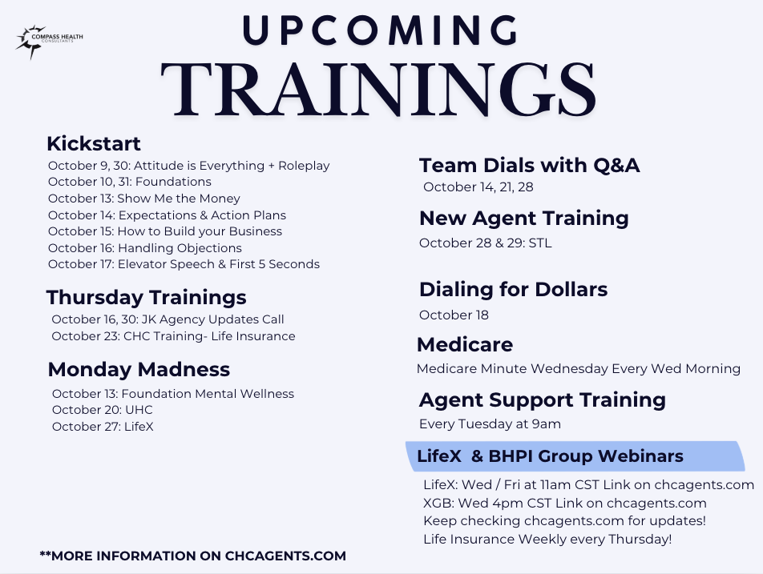

Slide 5


CHC OPEN ENROLLMENT RESOURCES
WE’RE HERE TO HELP!
  www.chcagents.com
  Upline
  TopBroker
  CHC Email
  Teemyco
  Slack
  Monday.com
  CHC Affiliate Website
  Business Cards
  CHC Humana DVL
  CHC Broker Swag Store
  Agency Update Calls
  Health Sherpa
  Healthcare.gov
  Additional Carrier Request Form
  Sales Tracking Sheet
  Carrier Contact Info
  Daily/Weekly Schedules
  Sales goals and strategies
  Handwritten Thank You’s
  BUNDLE!!!
Notes:
First year things can get lost or people don't make their premium payments. Having it all in a spreadsheet makes your life so much easier!

Slide 6


Slide 7

ACA and Open Enrollment
Bill Pauley will host an ACA training 12pm CST on Friday, October 17th!
You don’t want to miss this!
Link on chcagents.com!

Slide 8


Medicare Annual Enrollment Period
October 15 - December 7
Contact: Medicare@chcquotes.com for more information or join Medicare Minute Wednesday every Wednesday morning at 7:30am CST (Link on chcagents.com)

Slide 9
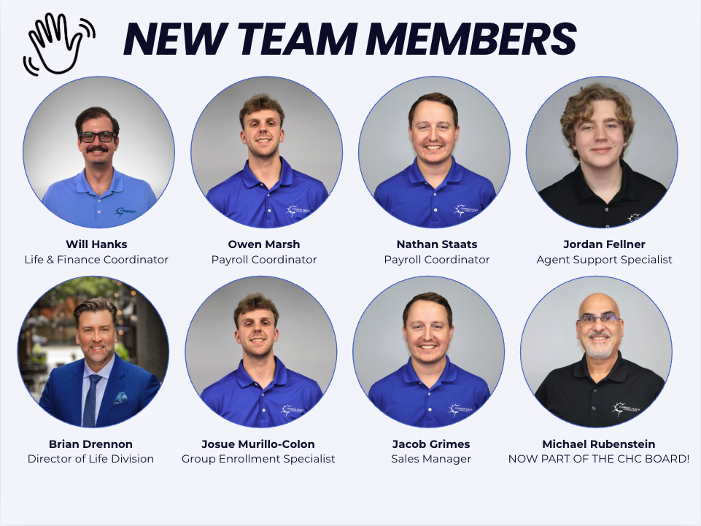

Slide 10


Life Insurance Division
Join our weekly trainings: Thursdays 5pm CST
Zoom ID: 436-392-8908
New Team Member Alert! To assist agent with discovery calls, program builds, closes, and training: Brian Drennon!
Email lifequotes@chcquotes.com for assistance!
Join the Passport Program! It provides:
-Opportunity
-Passive Income
-Growth
-Strengthens client relationships
-Increased Client Retention
Email passportsupport@chcagents.com to join TODAY!

Slide 11
Life Insurance Division
NEW CARRIER PARTNERSHIPS
Equita Group
CORE CARRIERS
AMAM
American General (AIG/Corebridge)
F&G
Foresters
MOO
TransAmerica
**Additional Carriers Available As Needed
LastingMark and Advisors Excel
CORE CARRIERS
SBLI
Nationwide
Americo
Principal
**Additional Carriers Available As Needed
Ameritas Life
Visit chcagents.com for contracting!
Contact: lifequotes@chcquotes.com for more details.

Slide 12



Marketing Updates!
OCTOBER NEWSLETTER OUT!
Www.chcagents.com → Resources → Marketing
LOGO & NAME UPDATE
Our company name and logo now proudly carry the ® symbol, marking a major milestone in our growth. This official trademark registration is more than just legal protection — it’s a recognition of the unique identity we’ve built and the trust our brand represents.
To reflect this across everything we do, the ® symbol should be included whenever our name or logo appears. On Windows, simply press Alt + 0174, and on Mac, use Option + R to insert the symbol.
This was emailed out - if you want to be added to our mailing list or to get the logo please email Marketing@chcquotes.com!

Slide 13

CONTRACTING UPDATES
Our NEW ACA contract will be going LIVE within the next couple weeks!
Coming soon for Open Enrollment - New ACA Contracting Platform!
Carriers like: Aetna, Anthem, BCBS, Cigna, and many, many more!
More details to come!
We’ve compiled a list of Carrier Agent Support information! Go to chcagents.com ⟶ Under 65 ⟶ Carrier Agent Support Information
October 1, 2025-January 1, 2026 there will be NO hierarchy changes so we can clean everything up and make sure we’re in the right place!
For new carrier requests find the link on chcagents or click HERE
Notes:
Elev8 Advanced Agent Training & Conference, St. Louis
September 18-19, 2025
TO QUALIFY TO ATTEND:
Must have been with CHC for 18 months, or less
Must have at least 3 completed sales/apps in Top Broker
COST: $300 per person (can't use marketing money).
CHC is giving a $60 credit for each completed sale/app. in Top Broker to be used toward your training expense (no cash value).
So, for example, if you have 3 apps in Top Broker, your out-of-pocket cost would be $120.
If you have 5 apps in Top Broker, you can attend at no out-of-pocket cost.
*EVENT IS BY INVITATION ONLY
To request an invitation, email: media@chcquotes.com
use "AAT INVITE" as the subject.
Send your:
date of hire
name
email
phone number

Slide 14
Payroll
UPDATES
NOVEMBER AGENT PAYROLL DATES THAT HAVE CHANGED:
You will be paid on:
November 10th
November 17th
November 24th
Thank you!

Slide 15
AWARD TRIP CONTEST
Rules
  Each application submitted and paid June 1 - Dec 22 2025 you’ll get the amount listed below of Travel Tokens towards cost of the trip
  All policies written from Jan 1 - May 31 2025 (Previously written) will be given 50% credit
  Top 15 agents and top 3 leaders (by Travel Tokens points) will attend the trip for free** (Free hotel accommodation + $750 towards flights per couple**)
  Leaders credit is ⅓ of their agents credit
Carrier | Compass Cash Per Policy Sold
LifeX | $15
Enroll Prime PSM OneShare | $10
AmeriBenefit Flex Benefits MedMutual NCD | $5
Group Health Policies (LEVEL FUNDED PLANS ONLY) | $5 per employee
For those that are NEW agents who’s first payroll was after June 1st 2025, all points are DOUBLED!
***Based on ACTUAL BUSINESS, not TopBroker
Notes:
Breathless in Punta Cana
GROUP TRACKING: Need to know effective dates of group
**Work with Brandie - she'll work with payroll to find out whats getting paid. Morrissey will help us.

Slide 16


TRIP UPDATES
Go to www.chcagents.com/tripupdates
Find document resources
If you want an invite reach out to events@chcquotes.com. Forthcoming there will be an evite sent out to the CHC agents.
We are sorry for the delay as we are working on a new email distribution list and hope to have the invitations out this weekend!
Also, please note that the deposits are ***due November 1st ($250 per person - see website for more info)
https://www.chcagents.com/tripupdates

Slide 17

X GROUP BENEFITS
  BHPI Group is now X Group Benefits!
  New Cigna EPO options for XGroup Plans starting 12/1
  XGroup Portal training expected 10/16/25!
  Renewals- All in Monday. Please start the conversation early with your client!
  Best Time to Cross Sell is at Renewal! D/V/L/STD/LTD/ Add Life
  Bernie Portal is there for your Clients! A Great Value add if they need it!
Additional training Thursday, October 16 at 3pm CST for XBG information!

Slide 18


Detego/PSM
Join the Detego Webinar today at 2pm CST
Link on chcagents.com or HERE
Notes:
courtney for major issues in bullet point form - court to speak on during call

Slide 19



Notes:
courtney for major issues in bullet point form - court to speak on during call

Slide 20




Top 10 Agents October 2025/Submitted
*Only Includes Agency Appointed Carriers
RANK
NAME
# OF APPS
1
2
3
4
5
6
7
8
9
10
Brent Miles
Megan & Ryan Williams
Trey Wilson
Jordan Krugman
Christopher Puccio
Tom Trifaro
Jennifer Earp
Jeff Crooks
Cyril Costello
Jan Rhonehouse
51
20
17
17
16
14
13
11
10
9
8

Slide 21



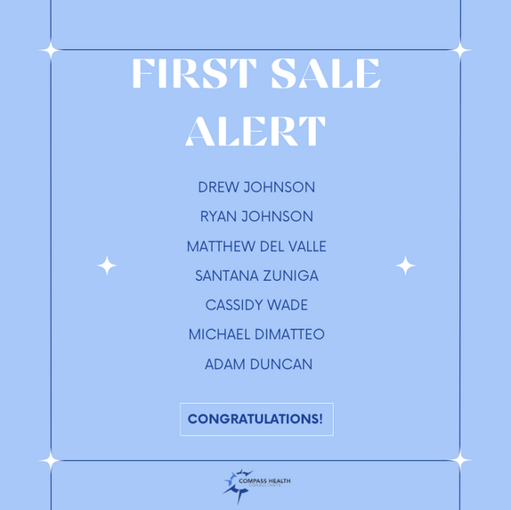
SALE!
Notes:
double check w tanya.
65 new people paid this month. math aint mathin

Slide 22

🎃 Pumpkin Decorating Fun! 🎃
Our staff is getting crafty and spooky with a pumpkin decorating contest at the end of the month!
👀 Keep your eyes peeled on our website and social media so YOU can vote for your favorite pumpkin and help us pick the winner! 🏆✨

Slide 23

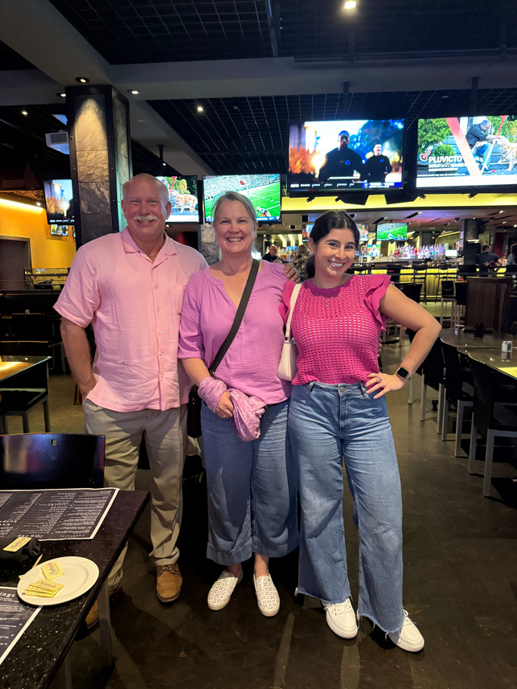
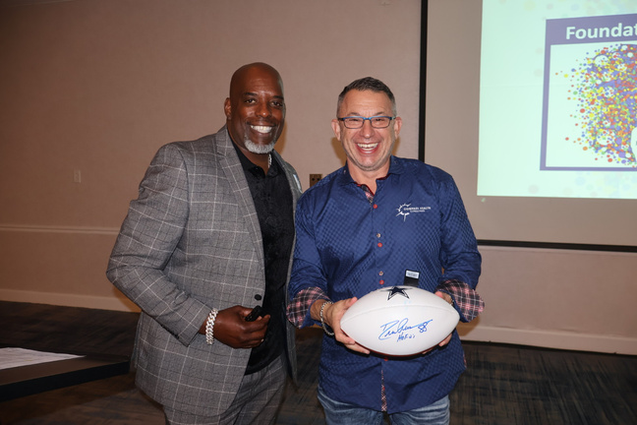
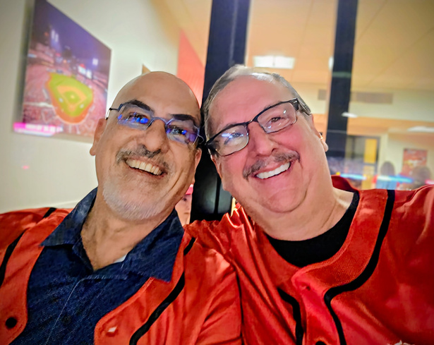
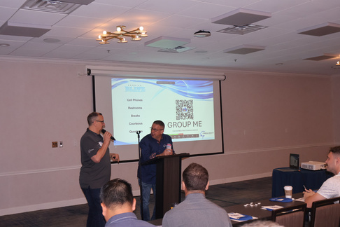
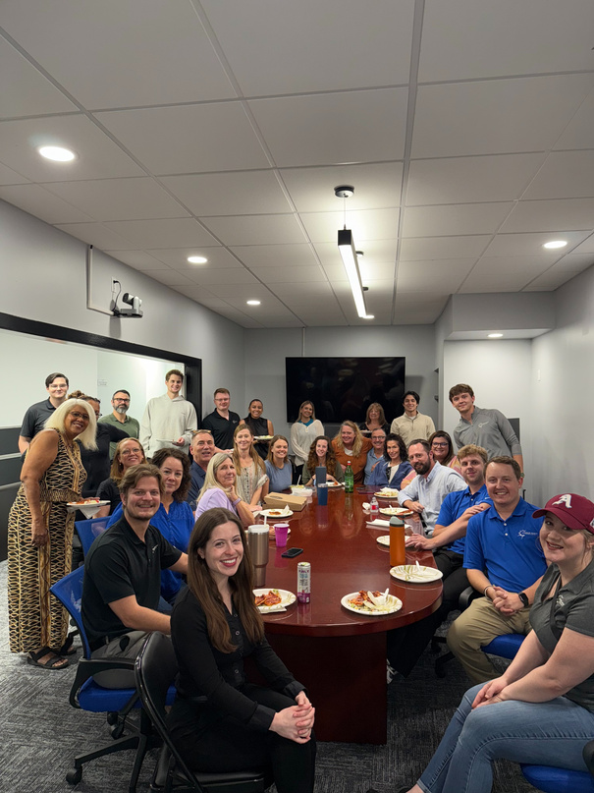

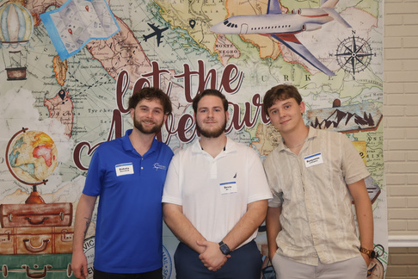

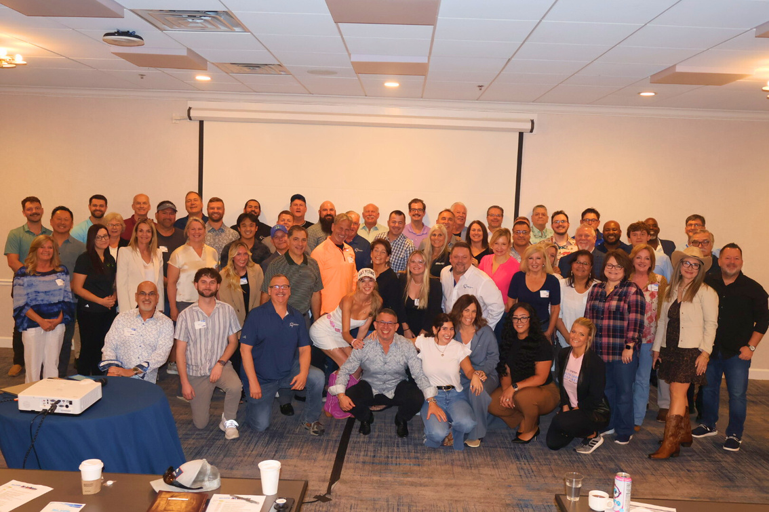
THE PIECES THAT MAKE CHC

Slide 24




Questions? Comments?
Next JK Update: Thursday October 16
Follow us on social media!

